Slide 1
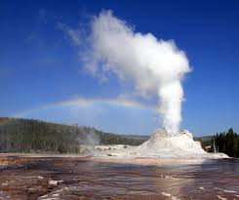
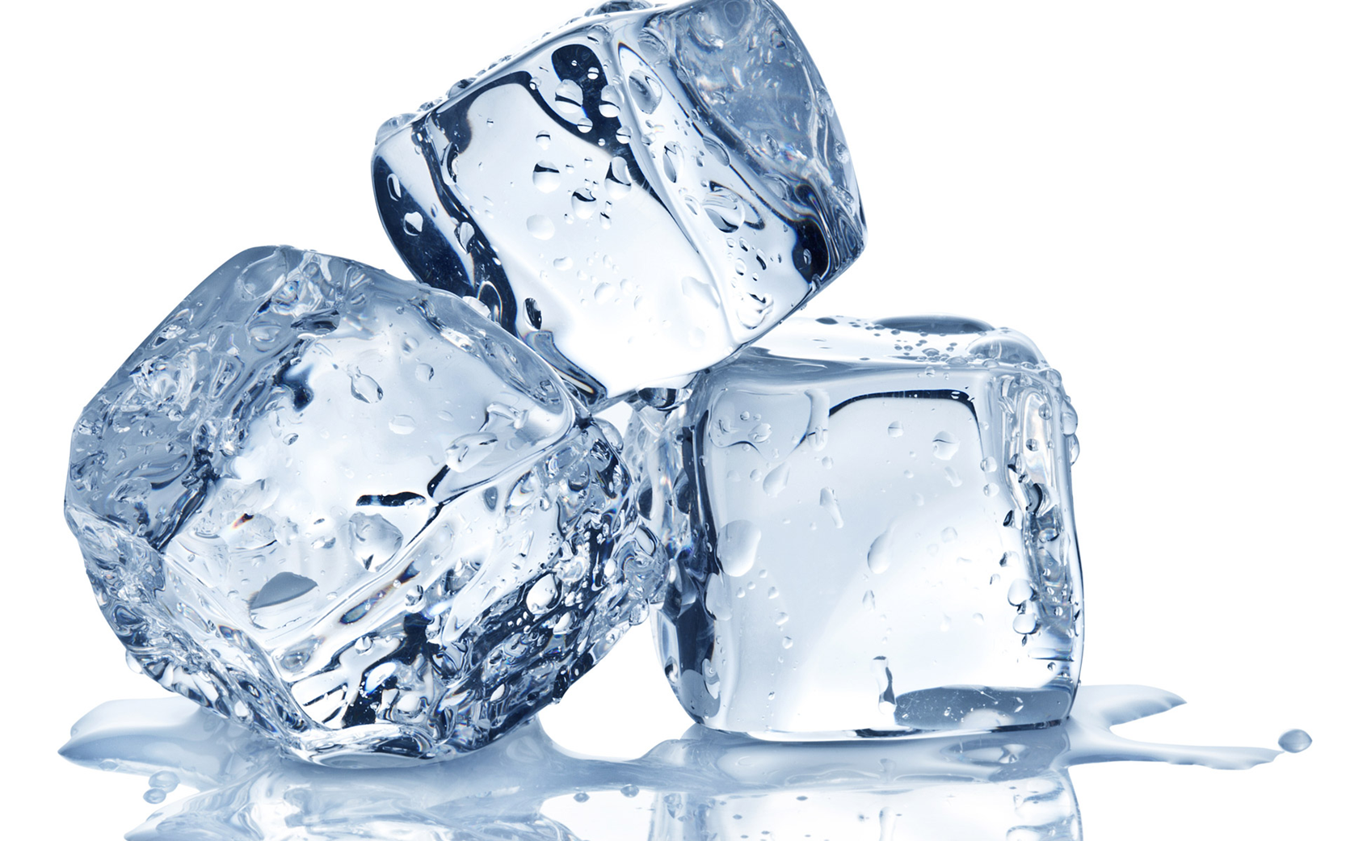
The states of matter
There are three states.
They are called solids, liquids and gas.
Most substances can exist in all three states but not at the same time.
Water can be solid: ice
liquid: water
or gas: steam
How does water change from one state to another?
You heat it or cool it.

Slide 2
You are going to measure the temperature when water changes states.
Questions:
How cold do you think this ice is?
What is the freezing point of water?
Can ice be colder than 0ºC?
What is the boiling point of water?
Can water be hotter than 100ºC?
You are going to find out for yourselves.

Slide 3
Measuring the melting point and the boiling point of water
Read through the instructions.
You are going to hold the thermometer in a clamp and stand. Do that now.
Be very gentle.
You are going to hang the thermometer in the middle of the ice so that it doesn‘t touch the bottom of the beaker.
Safety
Wear goggles
Don‘t touch the hot plate or the beaker or water when they are hot.
Follow the lab rules: no shouting, running, throwing things.

Slide 4
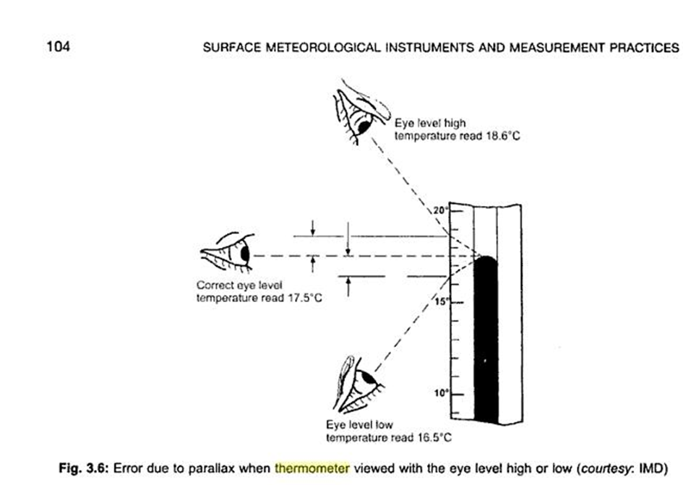
How do you use a liquid thermometer?
Make sure that the bulb is completely in the thing (usually air or liquid) which you want to measure.
Weight until the liquid stops moving up or down.
Look horizontally at the scale.

Slide 5
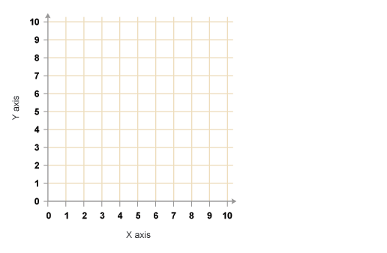
Your results
You need to plot your results on a graph.
What should you plot on your x-axis?
What should you plot on your y-axis?
Choose your scales so that all your results fit on.
- So your x-axis should go from 0 to 15 minutes and your y-axis should go from – 5 ºC to 105 ºC.
Temperature (ºC)
Time (seconds)

Slide 6
Conclusion
Make notes!
Ice can be colder than 0 ºC.
When you heat it, it melts at 0ºC.
When you carry on heating it, it boils at 100 ºC.
Water can‘t usually be hotter than the boiling point.

Slide 7
What have you learnt today?

