Slide 1
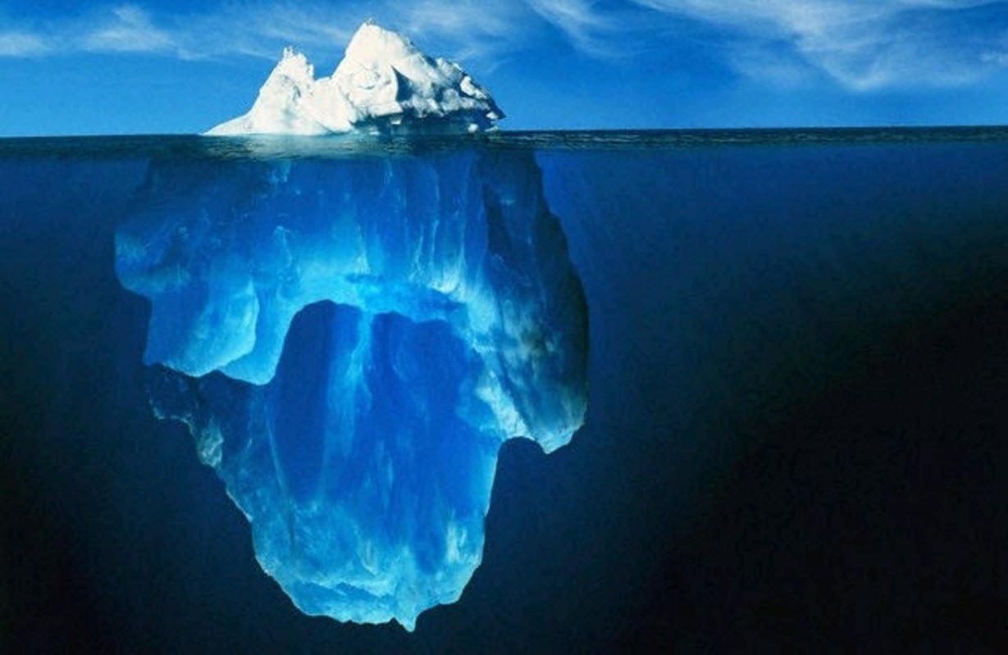
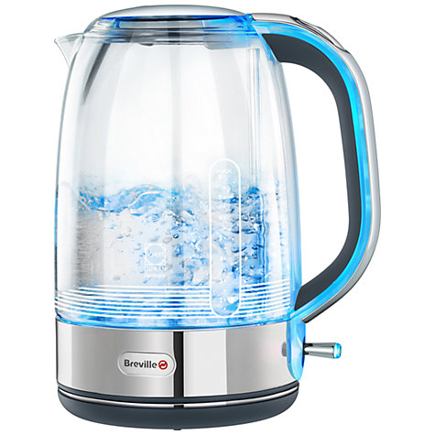
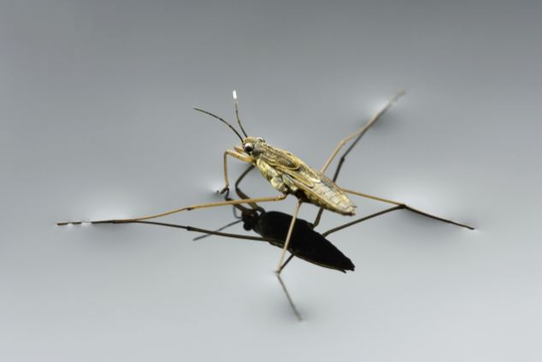
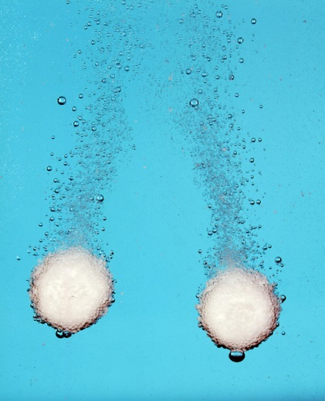
Special properties of water

Slide 2
Objectives
Describe the special properties of water and what causes them

Slide 3
Any ideas?

Slide 4
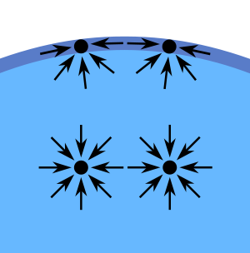
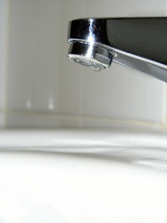
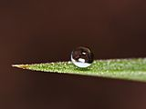
Surface tension
This is like a ‘skin’ on the surface of water
It is due to the water molecules pulling on each other due to hydrogen bonding
Surface tension is responsible for
The spherical shape of water droplets
Water beading on hydrophobic surfaces
Light objects floating on water

Slide 5
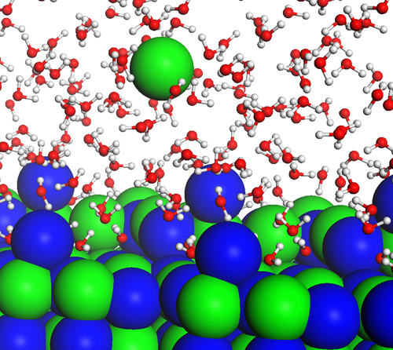
The best solvent
Water dissolves more substances than any other solvent
This is because the molecules are small and polar
It is a solvent for all chemical reactions in cells

Slide 6
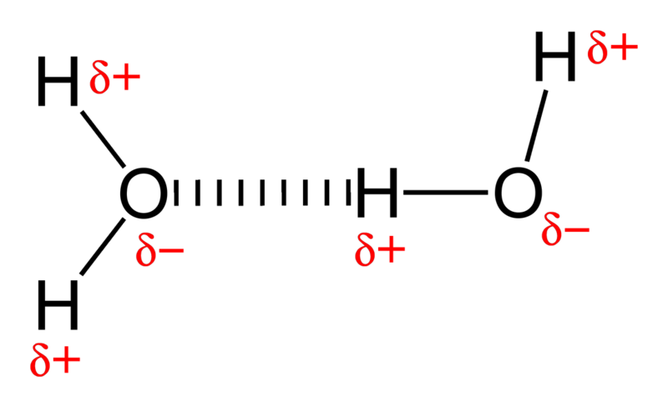
High boiling point
Hydrogen bonding means that water boils at a much higher boiling point than would otherwise be expected
Why is this important?

Slide 7
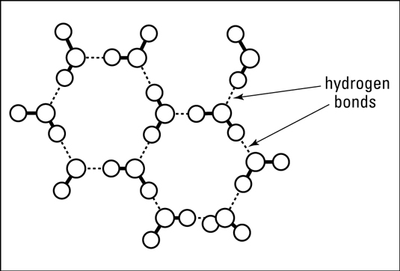
Expansion of ice
Normally, substances contract as they freeze, but ice expands, making it less dense
Ice expands due to hydrogen bonds which don’t allow the molecules to pack tightly together
Why is this important?

Slide 8
Objectives
Describe the special properties of water and what causes them

