Slide 1
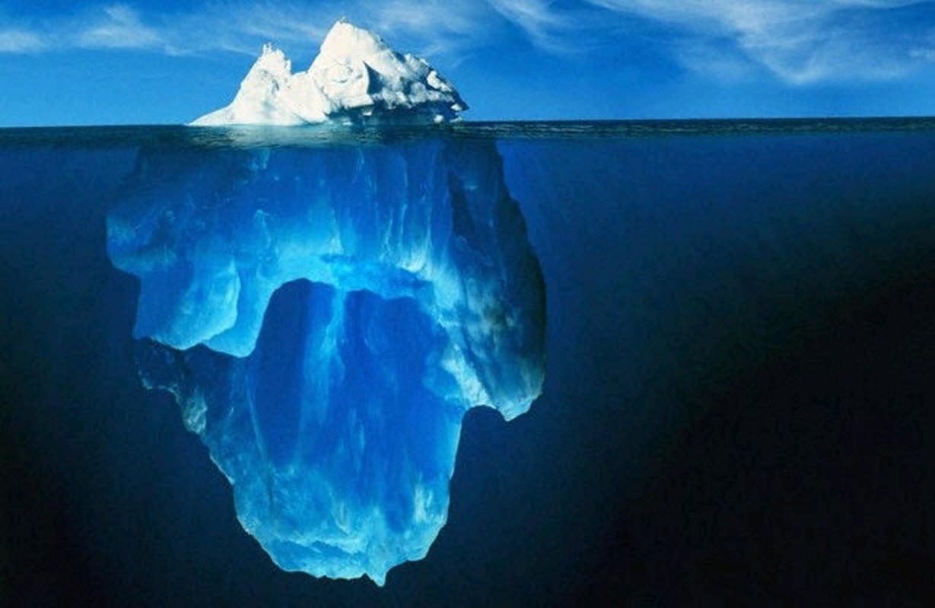
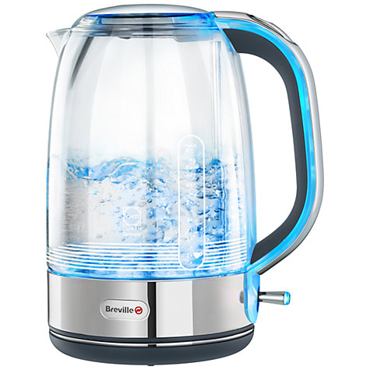
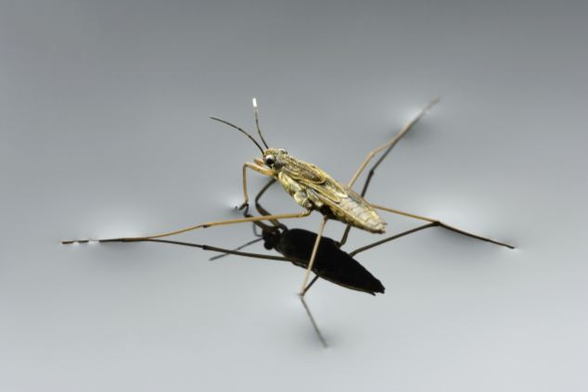
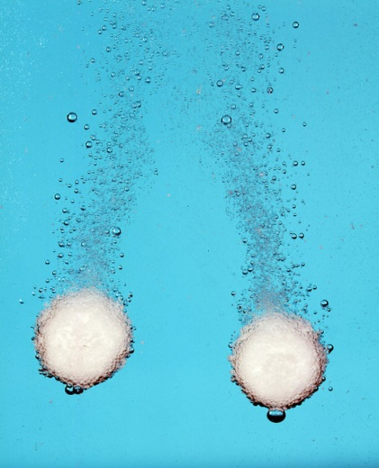
Special properties of water

Slide 2
WALT:
State at least 3 special properties of water
Describe the special properties of water and what causes them
Explain why these properties of water are important to us on a global scale.

Slide 3
Any ideas?
What properties do we know about water so far?

Slide 4
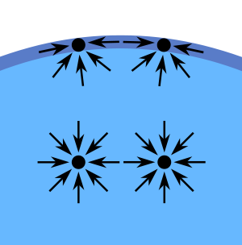
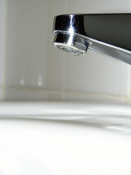
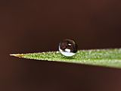
Surface tension
This is like a ‘skin’ on the surface of water
It is due to the water molecules pulling on each other due to hydrogen bonding
Surface tension is responsible for
The spherical shape of water droplets
Water beading on hydrophobic surfaces
Light objects floating on water

Slide 5
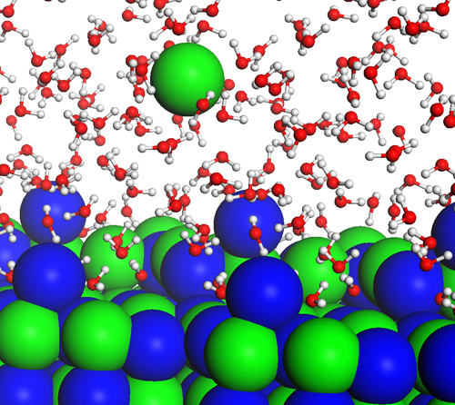
The best solvent
Water dissolves more substances than any other solvent
This is because the molecules are small and polar
It is a solvent for all chemical reactions in cells

Slide 6
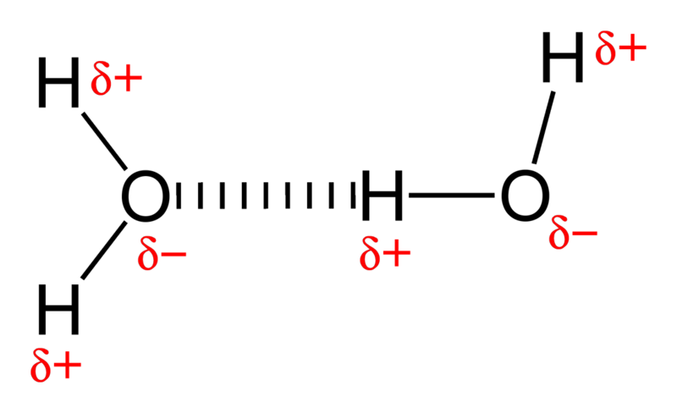
High boiling point
Hydrogen bonding means that water boils at a much higher boiling point than would otherwise be expected
Why is this important?

Slide 7
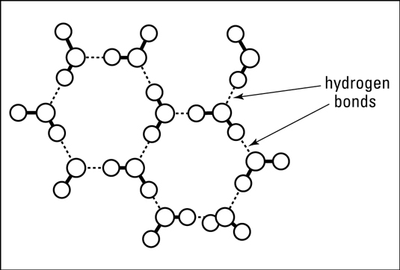
Expansion of ice
Normally, substances contract as they freeze, but ice expands, making it less dense
Ice expands due to hydrogen bonds which don’t allow the molecules to pack tightly together
Why is this important?

Slide 8
15 minutes.
Describe the special properties of water and what causes them. Use sentences, punctuation and paragraphs. Be careful with grammar and literacy.

Slide 9
Water purification Practical
Safety
• Remember that the blue flame of the Bunsen burner is for heating and can cause burns.
• The glassware will get hot; make sure it cools before you touch it.
• Steam from the boiling mixture can cause scalds.
• Wear eye protection

Slide 10
Literacy.
1
2
3
4
5
6
7
8
9

Slide 11
Literacy
1
2
3
4
5
7
8
9

Slide 12
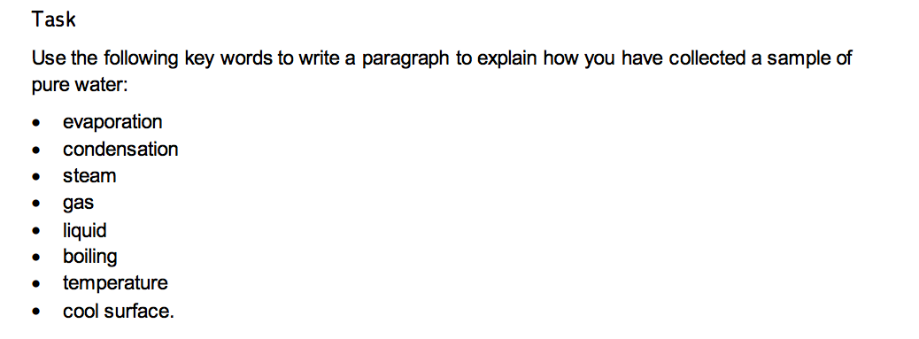
Using the apparatus list and key words, write a method to show how you would seperate the solution (mixture) into pure water (the solvent) and the solid (solute)

Slide 13
Write a method.

Slide 14
2

Slide 15
Practice Questions
1 Explain why it is important that the bulb of the thermometer is close to the opening of the delivery tube.
2 Explain why it is important to read the thermometer horizontally with the scale.
3 Explain why it is important that a smooth boil is achieved.
4 Anhydrous copper sulfate turns from white to blue in the presence of water. Explain how measuring the boiling point can be used to show the distillate is pure water, but the use of anhydrous copper sulfate cannot.

