Slide 1
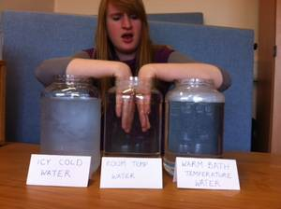
Thermometers, heat and temperature
How hot is it?

Slide 2
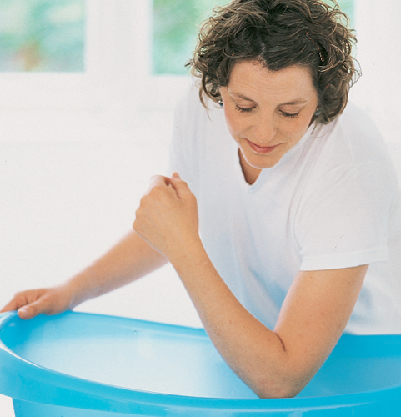
How hot is the water?
Put your hand in hot water and then in water at room temperature.
How does it feel?
Why does it feel like that?
Why do people test warm water with their elbow?
Answer the questions on the first page of your sheet.

Slide 3
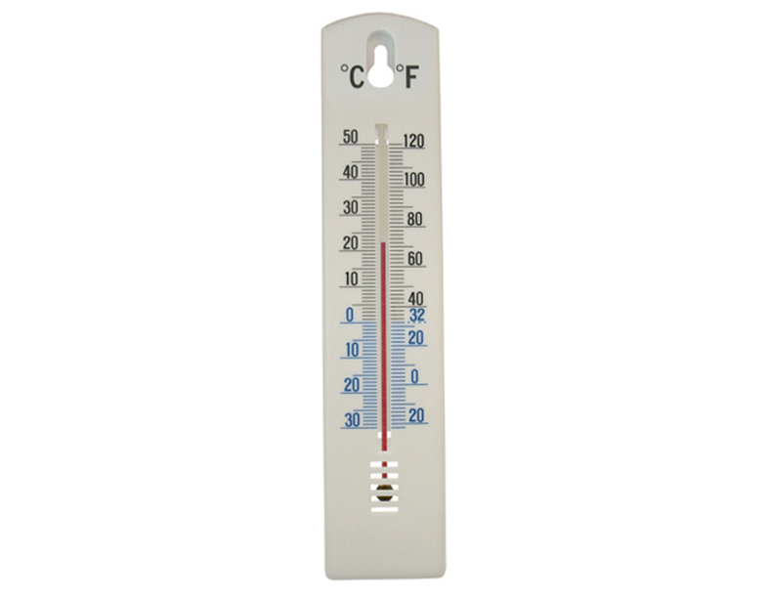
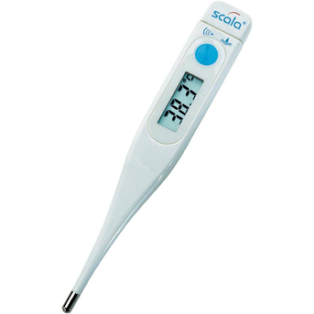
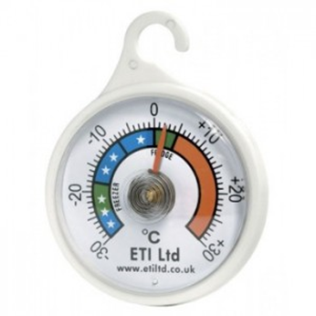
So how can you tell the real temperature?
A digital thermometer.
This measures your body temperature.
Use a thermometer!
There are different kinds of thermometer.
A liquid thermometer.
This one measures air temperature.
A bi-metal thermometer.
This measures the temperature in your freezer.

Slide 4
The parts of a liquid thermometer
Now fill in your worksheets and read about how to use the thermometer and the scales.

Slide 5
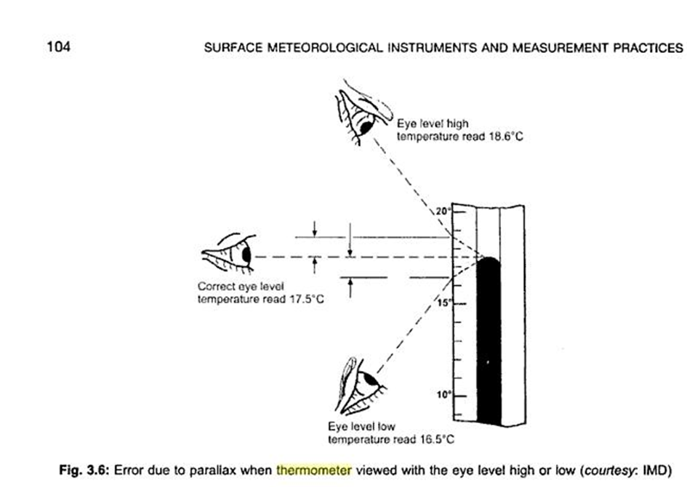
How do you use a liquid thermometer?
Make sure that the bulb is completely in the thing (usually air or liquid) which you want to measure.
Weight until the liquid stops moving up or down.
Look horizontally at the scale.

Slide 6
Measure the temperature
Use a liquid thermometer to measure the temperature of:
the air in the classroom __________
the air outside the classroom ___________
the temperature inside your clenched hand ____________
cold water running from the tap _________________
Safety –
Do not hold the thermometer too hard. Be careful with the glass.
Don‘t run with a thermometer in your hand.
If you break the glass, tell me straight away.

Slide 7
Read about the three scales.
Now answer the questions:
Water freezes at _______ ºC, ________ºF and ________K
Water boils at _______ ºC, _________ºF and ________K
Where is the Fahrenheit scale used? _________________
Where is the Centigrade scale used? _________________
Who uses the Kelvin scale? ________________

Slide 8
What have you learnt today?

