Slide 1
Metalic bonding WALT:
To describe how the atoms in metals are arranged
How the atoms are bonded together
To grow our own silver
Why metals can be bent and shaped without breaking
Why alloy areharder than pure metals
Why metals conduct electricity and thermal energy

Slide 2
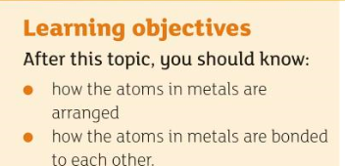
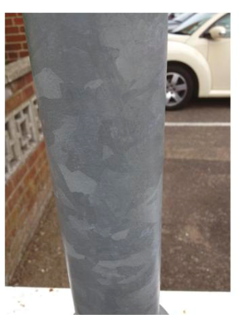
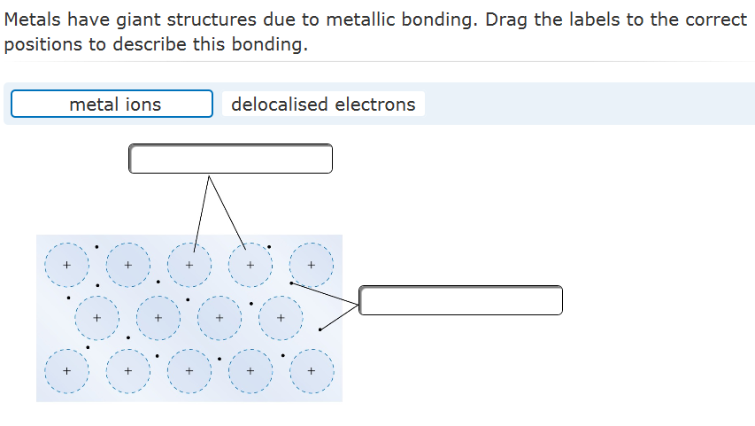
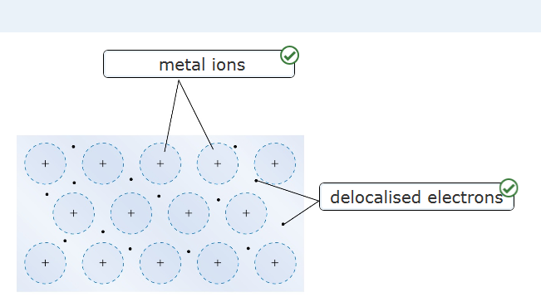
Starter: Answer this question

Slide 3
Metallic bonding
Metals are giant structures
Lattice of +ly charged ions
Arranged in regular layers
‘Sea’ of free moving electrons delocalised electrons
Surrounding the +ly charged metal ion
Strong electrostatic attraction between the –ly charged electrons and the +ly charged ions bond the metal ions to each other.
Key
+ly= positively
-ly= negative
http://www.bbc.co.uk/education/guides/zfsk7ty/activity

Slide 5
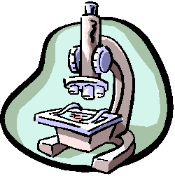
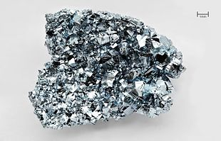
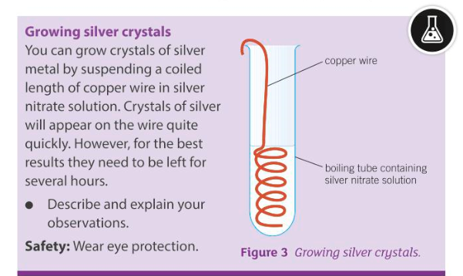
Practical session: Growing silver crystals
Will displacement take place?
Which is the most reactive metal: copper or silver? Check your notes
Copper
Silver nitrate

Slide 6
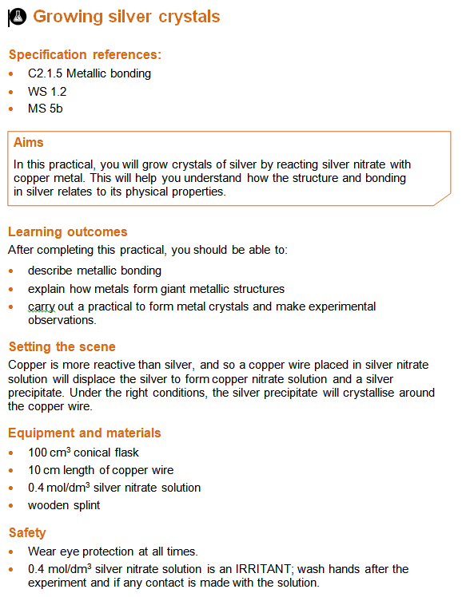

Slide 7
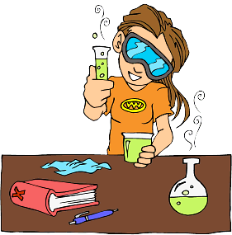
Method
Half fill the boiling tube with silver nitrate solution.
Wind the copper wire into a corkscrew shape and wrap the end around the middle of a splint.
Put the wire into the conical flask, so that at least half of the corkscrew shape is submerged. The splint ensures that the wire does not fall into the liquid.
Note the appearance of the reactants and products after 10 minutes and again after 20 minutes.

Slide 8
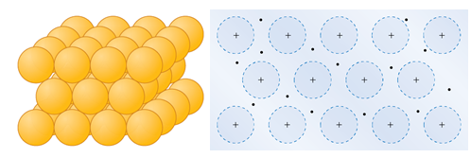
Answer the following questions:
1 A Write a word equation for the reaction that occurred between the copper wire and the zinc nitrate solution.
(1)
b Complete the symbol equation for this reaction. Make sure the equation is balanced.
2 Below are two different ways of showing the structure of silver metal.
a Describe the key features of metals displayed by each diagram.
b. Describe metallic bonding.
c. With reference to the bonding in metals, suggest why the silver in this practical forms in crystals.

Slide 9
Check your answers
Copper + zinc nitrate-> no reaction

Slide 10
Practise

Slide 11
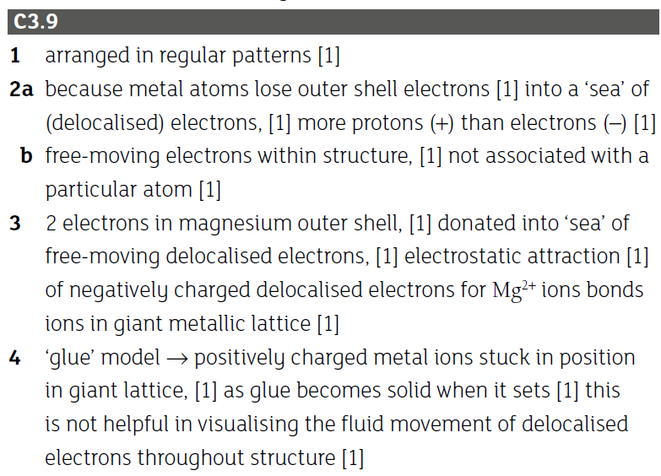

Slide 12
Spare time? http://ed.ted.com/lessons/how-to-squeeze-electricity-out-of-crystals-ashwini-bharathula

