Slide 1
Clicker Questions for Molecule Polarity
AUTHORS
Trish Loeblein (University of Colorado Boulder)
Robert Parson (University of Colorado Boulder)
COURSE
Introductory / Preparatory College Chemistry
COPYRIGHT: This work is licensed under a Creative Commons Attribution 4.0 International License.

Slide 2
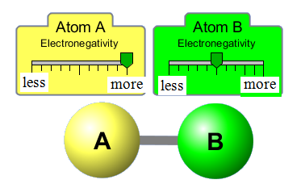
Which is the best description for this bond?
nonpolar covalent
polar covalent
Ionic
Notes:
Sim warm-up: Present this question after exploration of the Two Atom screen of the simulation.
Correct answer: B
Representative results from pre-general chemistry: 85% correct (next most popular answer is C)
Follow-up discussion: Ask students how they decided on their answer, specifically focusing on the difference in electronegativities.

Slide 3
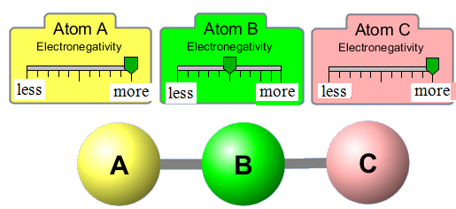
The molecule shown would be described as:
polar bonds, nonpolar molecule
nonpolar bonds, nonpolar molecule
polar bonds, polar molecule
nonpolar bonds, polar molecule
Notes:
Sim demonstration: Present this question after exploration of the Three Atom screen of the simulation.
Goal: Connect bond polarity with molecule polarity, recognizing that polar bonds don’t necessarily imply a polar molecule.
Correct answer: A
Representative results from pre-general chemistry: 55-70% correct (next most popular answer is C)
Follow-up discussion: Ask students how the decided on their answer. Use the simulation to show the individual bond polarity and (overall) molecule polarity arrows.

Slide 4
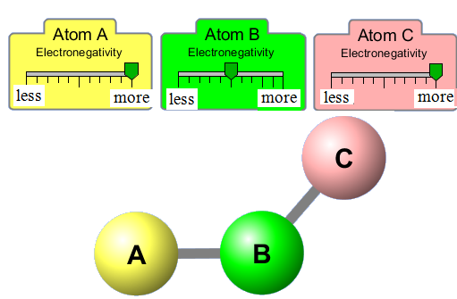
The molecule shown would be described with
polar bonds, nonpolar molecule
nonpolar bonds, nonpolar molecule
polar bonds, polar molecule
nonpolar bonds, polar molecule
Notes:
Sim demonstration: Present this question after exploration of the Three Atom screen of the simulation.
Goal: Connect bond polarity with molecule polarity, recognizing that polar bonds don’t necessarily imply a polar molecule.
Correct answer: C
Representative results from pre-general chemistry: ~80% correct
Follow-up discussion: Ask students how the decided on their answer. Use the simulation to show the answer, particularly by turning the bond polarity and molecule polarity arrows on.

Slide 5
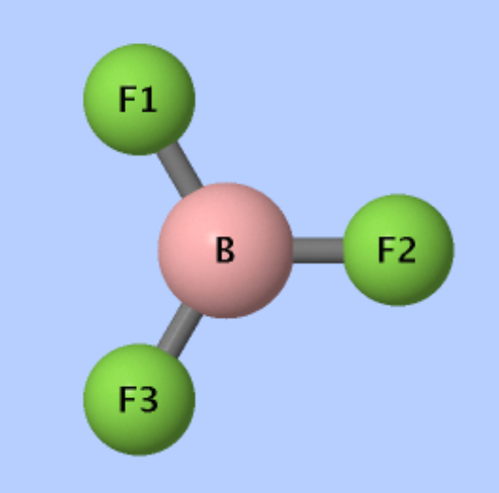
How would you describe the trigonal planar molecule BF₃?
polar bonds, nonpolar molecule
nonpolar bonds, nonpolar molecule
polar bonds, polar molecule
nonpolar bonds, polar molecule
Notes:
Goal: Extend the comparison between bond polarity vs. molecule polarity into 3-dimensions, using this question and the following one.
Correct answer: A
Follow-up discussion: Ask students how the decided on their answer. Use the simulation to show the answer, particularly by turning the bond polarity and molecule polarity arrows on in the Real Molecules tab.

Slide 6
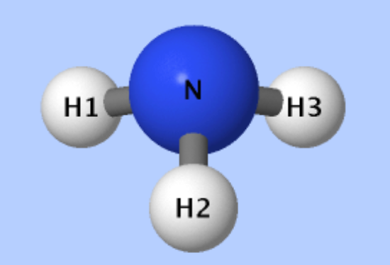
How would you describe the
trigonal pyramidal molecule NH₃?
polar bonds, nonpolar molecule
nonpolar bonds, nonpolar molecule
polar bonds, polar molecule
nonpolar bonds, polar molecule
Notes:
Goal: Extend the comparison between bond polarity vs. molecule polarity into 3-dimensions, using this question and the following one.
Correct answer: C
Follow-up discussion: Ask students how the decided on their answer. Use the simulation to show the answer, particularly by turning the bond polarity and molecule polarity arrows on in the Real Molecules tab.

Slide 7
Which of the following molecules are polar?
CF₄
CH₃F
CH₂F₂
Both (a) and (b)
Both (b) and (c)
Notes:
Correct answer: D
Representative results from pre-general chemistry: 46% correct (all remaining answers except A were roughly equally popular)
Follow-up discussion: Ask students how the decided on their answer. Use the simulation (Real Molecules Tab) to show the answer, particularly by turning the bond polarity and molecule polarity arrows on.

