Slide 1
Metals & non-metals
- a comparison of properties

Slide 2
WALT:
To describe the properties of metals
To describe the properties of non metals
Display data in a graph to show differences between the groups
Explain why the differences occur using bonding types.

Slide 3
You will know that elements can be divided into
metals
and
non-metals
If you know the property of a metal
The property of a non-metal
will almost always be the opposite
So metals are ...
SHINY
MALLEABLE & DUCTILE
GOOD conductors electricity
in the SOLID STATE
usually have HIGH melting points
form OXIDES known as BASES
Reactivity INCREASES down a group

Slide 4
metals are ...
non-metals are ...
SHINY
usually DULL
MALLEABLE & DUCTILE
usually BRITTLE
GOOD conductors electricity
POOR conductors electricity
in the SOLID STATE
in the SOLID STATE
usually have HIGH melting points
usually have LOW melting points
form OXIDES known as BASES
form OXIDES that are ACIDIC
Reactivity INCREASES
Reactivity DECREASES
down a group
down a group

Slide 5
Metals & non-metals can be located in
the Periodic Table
H
H
He
He
Li
Li
Be
Be
B
B
C
C
N
N
O
O
F
F
Ne
Ne
Na
Na
Mg
Mg
Al
Al
Si
Si
P
P
S
S
Cl
Cl
Ar
Ar
K
K
Ca
Ca
Fe
Fe
Sn
Cu
Sn
Cu
Zn
Zn
Br
Br
Kr
Kr
Ag
Ag
Pb
Pb
I
I
Xe
Xe
Au
Au
shows the non-metals
Where are the transition metals?

Slide 6
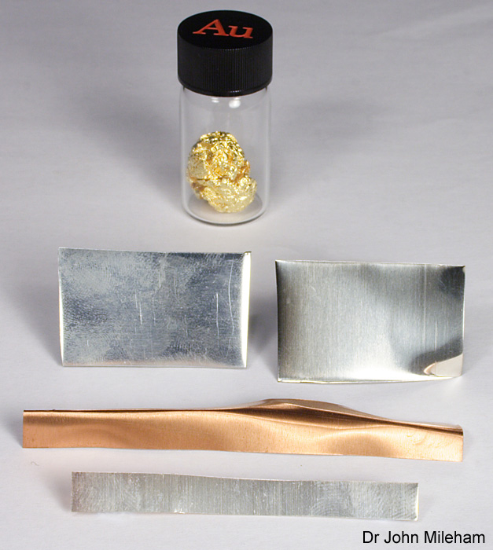
Transition metals…..Why are they called the ‘typical metals’?
There are over 30 transition metals.
They include most of the metals we are familiar with and use everyday, such as iron, copper and gold.
However, there are many transition metals that are less familiar to us, because they are very rare or have few uses.
The transition metals are known as ‘typical’ metals.
Why do you think this might be?
Notes:
Photo credit: Dr John Mileham
Image is of a selection of transition metals. These are, from the back:
Gold (in bottle);
Zinc (left) and nickel (right);
Copper;
Silver.

Slide 7
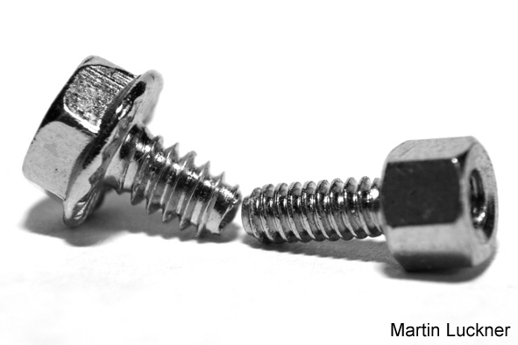
Comparing properties of different metals
How do the properties of transition metals compare with those of alkali metals?
Compared to the alkali metals, the transition metals:
are harder and stronger. They cannot be cut with a knife.
are more dense. This means that in a fixed volume of metal there are more atoms of a transition metal than there are of an alkali metal.
have higher melting and boiling points – except mercury.
Notes:
Photo credit (left): © 2007 Jupiterimages Corporation
Photo credit (right): Martin Luckner

Slide 8
Melting point, boiling point and density of metals.

Slide 9
Melting and boiling point of group 7 non metals.

Slide 10
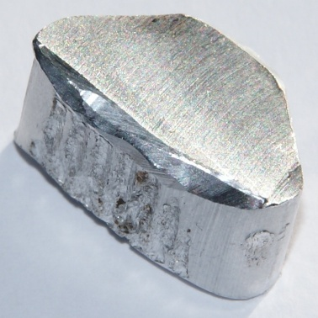
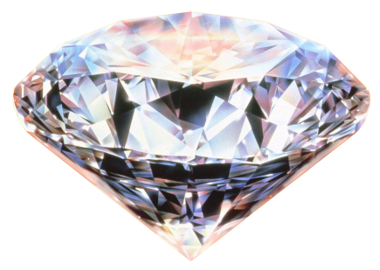
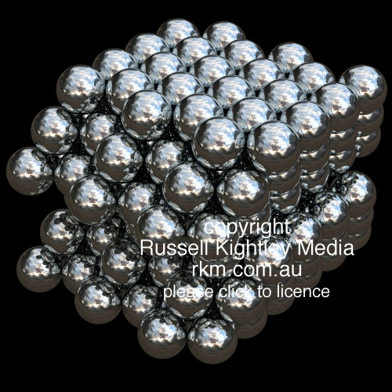
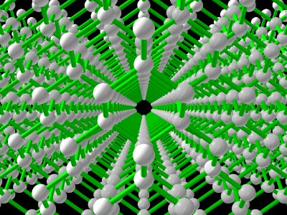
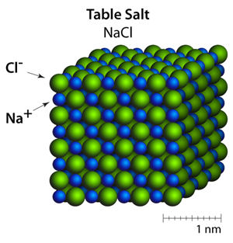
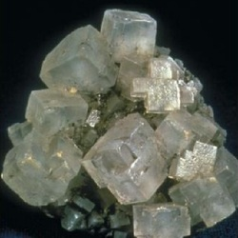
Why do metals usually have HIGH melting points?
Any substance that has a HIGH melting point must
have a GIANT structure
have a STRONG BONDS
substances with HIGH melting point can be .....
GIANT covalent
METALS
IONIC compounds

Slide 11
Why do metals usually have HIGH melting points?
METALS exist as a GIANT structure of ATOMS
This GIANT structure of ATOMS is held together
with STRONG METALLIC BONDS

Slide 12
Why do metals usually have HIGH melting points?
What are metallic bonds?
Use lithium as an example.
+
Metal Li ions
-
are surrounded by
e
-
delocalised electrons
+
e
+
+
Li
Li
Li
These electrons are attracted to the POSITIVE ions -
-
-
-
e
-
e
e
e
-
e
and the POSITIVE ions are attracted to the electrons.
Li
+
Li
+
Li
+
-
-
e
e

Slide 13
Why do metals usually have HIGH melting points?
What are metallic bonds?
Metallic bonds arise as a result of .....
the attraction between delocalised electrons and ....
the POSITIVE ions
The MORE delocalised electrons the HIGHER the m.pt.
Predict which has the HIGHER melting point ...
magnesium (group II) or aluminium (group III)
ALUMINIUM as it has THREE delocalised electrons
for every ION
The ALUMINIUM ion as it has a +3 charge,
The magnesium ion only has a +2 charge

Slide 14
Why do non-metals usually have LOW melting points?
Almost all non-metal elements are COVALENTLY bonded
forming MOLECULES
e.g.
hydrogen (H2)
oxygen (O2)
sulfur (S8)
iodine (I2)
Covalent bonds (a shared PAIR of electrons) are very STRONG
and arise because of the attraction between this PAIR electrons
and the nuclei of atoms at the end of the bond
For HYDROGEN (H2)
H
H
H
H
Covalent bonds are NOT easily broken on heating
What are broken?
the forces BETWEEN the molecules or
INTERMOLECULAR
FORCES

Slide 15
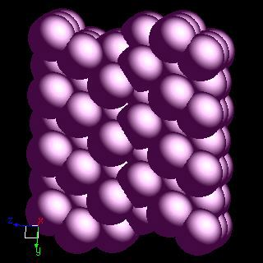
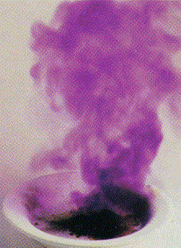
Why do non-metals usually have LOW melting points?
INTERMOLECULAR are very WEAK
Little ENERGY is needed to break them ...
so the MELTING POINT is LOW
e.g.
iodine (I2) – a solid -sublimes
All non-metal elements behave in the same way to increasing heat
except DIAMOND, GRAPHITE & SILICON
These have very HIGH melting points

Slide 16
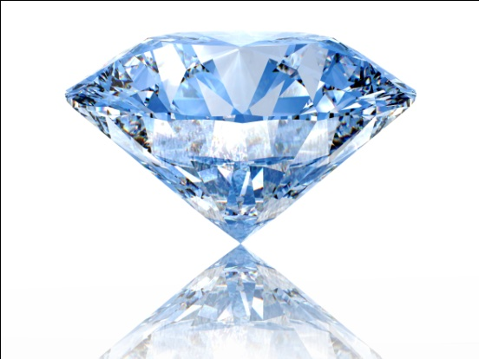
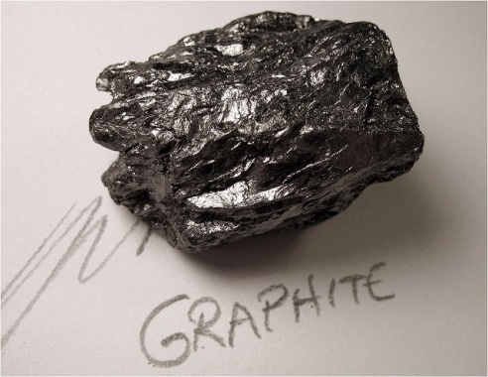
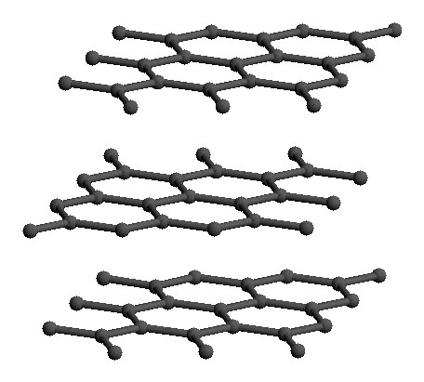
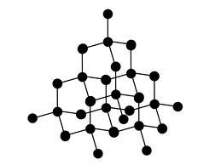
Why do Diamond & graphite have HIGH melting points?
diamond & graphite have GIANT COVALENT structures
Both have MANY STRONG covalent bonds
needing LARGE amounts of energy to break .......
so both have very HIGH ‘melting’ points
Diamond has only STRONG covalent bonds (tetrahedrally arranged),
making it HARD

Slide 17
Why is graphite SOFT?
existing in LAYERS
Graphite has a GIANT COVALENT structure
between the LAYERS are WEAK INTERMOLECULAR forces
these can easily be broken by applying a small amount of pressure
so the layers SLIDE over each other,
making it SOFT

Slide 18
Why are metals malleable and ductile?
look at the structure
The atoms are identical
and exist in
layers
Applying a force to a layer
causes them to
slide
over each other

Slide 19
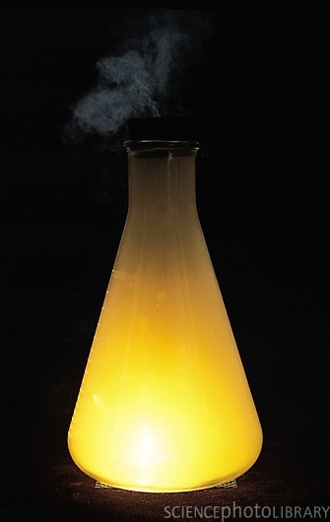
Why are metal oxides BASES & non-metal oxides ACIDS?
When metals burn in oxygen, they react to produce metal OXIDES.
e.g. magnesium burning
e.g. sodium burning
In both of these examples, solid oxides are made.
They do NOT affect DRY LITMUS or UNIVERSAL indicator paper
Water must be present.
It reacts with the oxide to make a hydroxide.
e.g.
sodium oxide + water sodium hydroxide
Hydroxide ions (OH ) cause a soluble substance to be ALKALINE ...
and have a pH GREATER than 7.

Slide 20
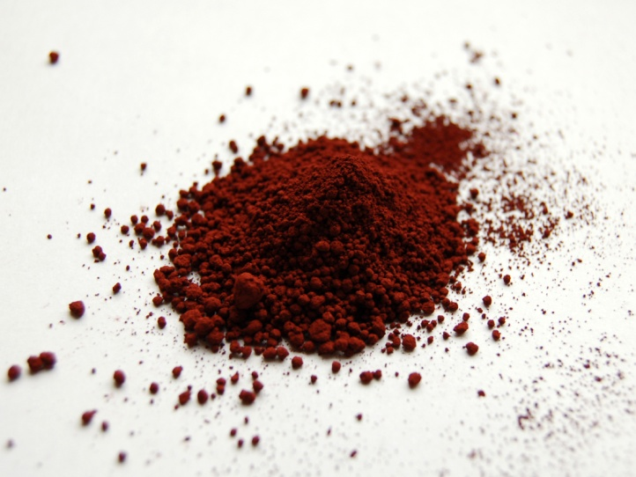
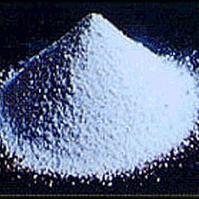
Why are metal oxides BASES & non-metal oxides ACIDS?
Metal oxides that do NOT react with water, have a pH value of 7
e.g. iron (III) oxide - RUST
e.g. aluminium oxide
The oxides will, however, NEUTRALISE acids to make a SALT & WATER.
e.g.
aluminium oxide + hydrochloric acid aluminium chloride + water
2Al2O3(s) + 6HCl(aq) 2AlCl3(aq) + 3H2O(l)
e.g.
iron (III) oxide + nitric acid iron(III) nitrate + water
2Fe2O3(s) + 6HNO3(aq) 2Fe(NO3)3(aq) + 3H2O(l)

Slide 21
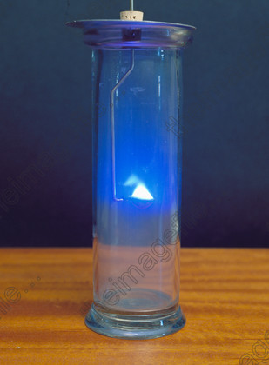
Why are metal oxides BASES & non-metal oxides ACIDS?
When non-metals burn in oxygen, they react to produce non-metal OXIDES.
e.g. sulfur burning
e.g. carbon burning
In both of these examples, gaseous oxides are made.
They do NOT affect DRY LITMUS or UNIVERSAL indicator paper
Water must be present.
It reacts with the oxide to make an ACID.
e.g.
sulfur dioxide + water sulfurous acid
SO2(g) + H2O(l) H2SO3(aq)
+
The acid molecule dissociates, into H ions and an anion
+
2-
H2SO3(aq) 2H (aq) + SO3 (aq)
and have a pH LESS than 7.

Slide 22
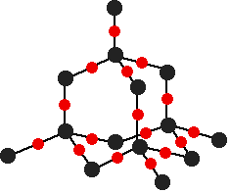
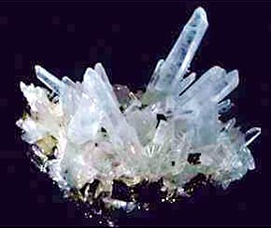
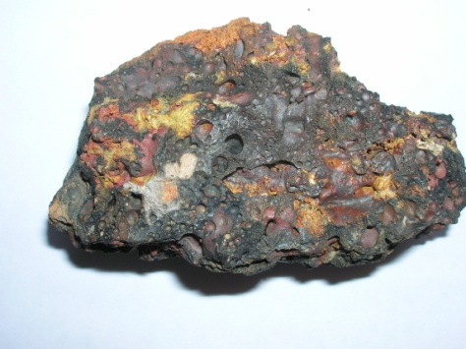
Why are metal oxides BASES & non-metal oxides ACIDS?
Non-metals oxides that are insoluble in water have a pH value of 7
e.g. silicon dioxide (SiO2)
This oxide will, however, NEUTRALISE BASES e.g. calcium oxide (CaO)
This is a particularly important reaction in the BLAST FURNACE
silicon dioxide + calcium oxide calcium silicate
i.e.
SiO2(s) + CaO(s) CaSiO3(s)
This is a NEUTRALISATION reaction
This removes sand impurities
as SLAG

Slide 23
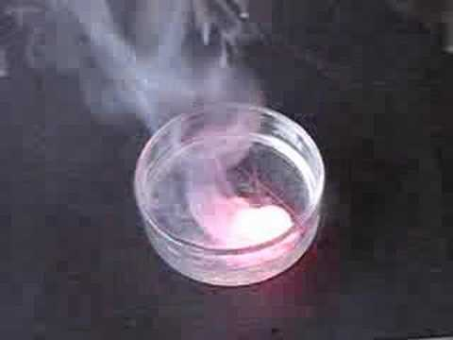
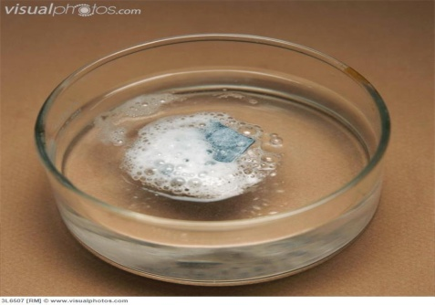
Why does the reactivity of metals increase down a group?
Metals react by LOSING electrons.
OXIDATION
The easier it is to lose an electron the MORE reactive the metal.
e.g. potassium is MORE reactive than lithium.
Why?
This depends on how the electrons are arranged.
In particular:
how far the outermost electron(s) is from the nucleus
how shielded the electron is
(the MORE occupied shells, the GREATER the shielding
and the LOWER the attraction of the nucleus for the outer electrons)

Slide 24
Why does the reactivity of metals increase down a group?
e.g. potassium is MORE reactive than lithium.
Why?
The electron arrangements are:
Potassium
2, 8, 8, 1
Lithium
2, 1
electron to be LOST
smaller distance from nucleus
greater distance from nucleus
1 shield
3 shields
Potassium’s outermost electron is less strongly attracted

Slide 25
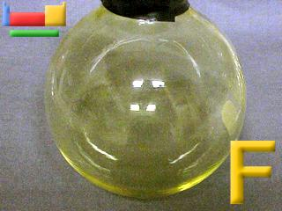
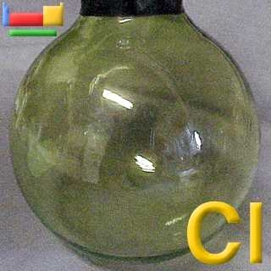
Why does the reactivity of non-metals decrease down a group?
Non-metals react by GAINING electrons.
REDUCTION
The easier it is to gain an electron the MORE reactive the non-metal.
e.g. Fluorine is MORE reactive than chlorine.
Why?
This depends on how the electrons are arranged.
In particular:
how far the outermost shell is from the nucleus
how shielded that shell is
(the MORE occupied shells, the GREATER the shielding
and the LOWER the attraction of the nucleus for the incoming electron)

Slide 26
Why does the reactivity of non-metals decrease down a group?
e.g. fluorine is MORE reactive than chlorine.
Why?
The electron arrangements are:
fluorine
2, 7
chlorine
2, 8, 7
electron to be gained
distance of closest approach
1 shield
2 shields
Fluorine attracts the new electron MORE strongly .....
fluorine is MORE reactive, than chlorine

