Slide 1
Genetics : Knowledge harvest
How many of these words do you know :
genotype allele DNA
phenotype dominant gene chromosome
gene recessive gene nucleotides
trait Punnett square nucleosome
histone locus genome
Traffic light system
Red – I have not got a clue ☹
Orange – I have heard of this word before but I am not 100% sure about its meaning.
There is still hope for me :-0
Green – Hooray!!! I am so clever ☺ I know the word and its meaning! Well done to me.

Slide 2
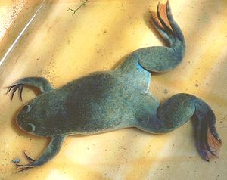
Clawed frog experiment (Krallenfrosch)

Slide 3
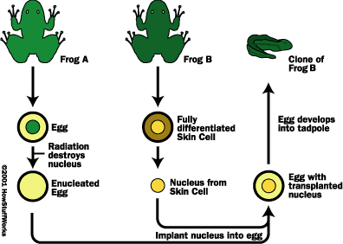
Experiment (by J. Gurdon,1961)
Notes:
Copy

Slide 4
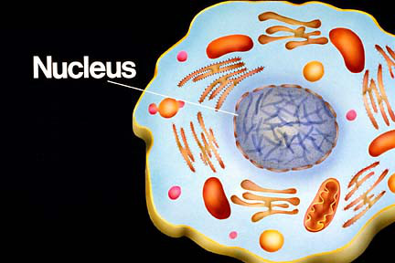
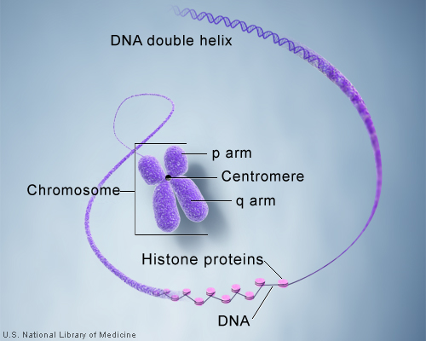
Nucleus is the control centre of
the cell. It determines what the
cell does and how it looks.
Contains the genetic material
of the cell.
Chromosome is a thread-like structure in the nucleus
where DNA is tightly packed around histone proteins.
Do you know how many chromosomes are there
in your cell?
Source : Genetics Home Reference

Slide 5
Human chromosomes – 23 pairs

Slide 6
Human chromosomes – just before cell division

Slide 7
kinetochore
Source :http://y12hb.wordpress.com/

Slide 8
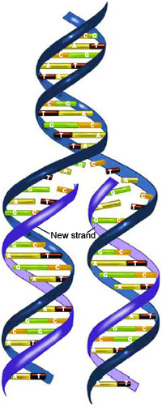
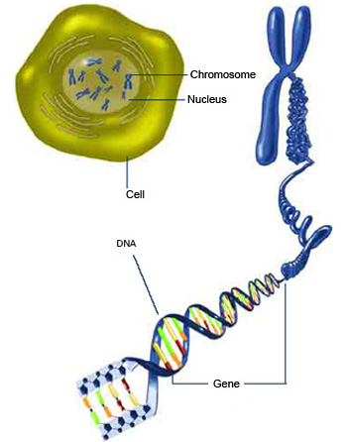
DNA is a double helix structure that carries all the hereditary material from one
generation to the other.
Source :http://publications.nigms.nih.gov/thenewgenetics/chapter1.html#c1
http://www.yourgenome.org/teachers/origami.shtml

Slide 9
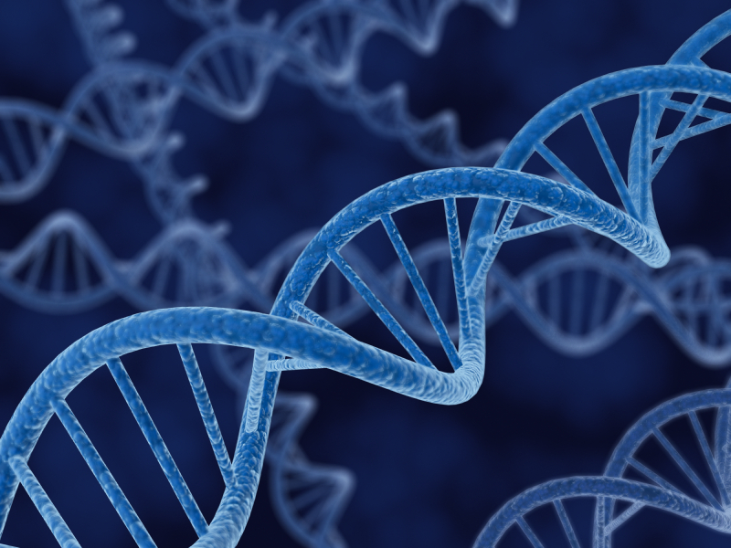
WALT know what DNA is
DNA stands for deoxyribonucleic acid.
A DNA molecule is made up of thousands of nucleotides.
Each nucleotide is made up of 3 parts :
A phosphate group
A sugar group
One of four types of nitrogen base
Source : thedailysheeple.com

Slide 10
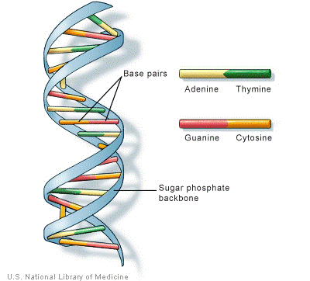
DNA is a double helix strand that is held together by hydrogen bonds.
There are four types of nitrogen base :
A- adenine
T- thymine
C - cytosine
G – guanine
The double helix structure was discovered by Watson and Crick in 1953.

Slide 11
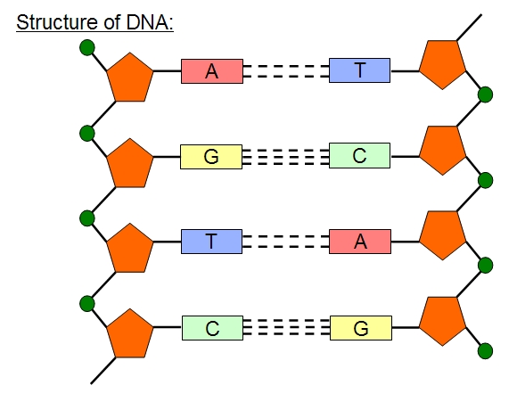
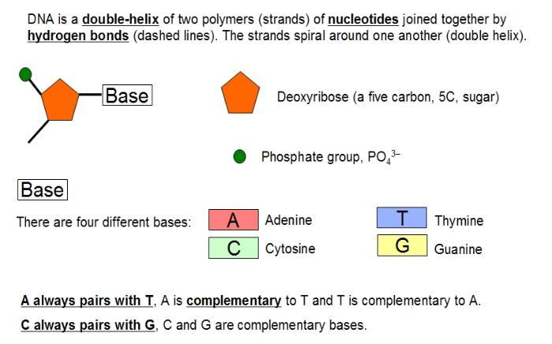

Slide 12
DNA Origami
https://www.youtube.com/watch?v=0jOapfqVZlo
http://www.passmyexams.co.uk/GCSE/biology/structure-of-dna-molecule.html

Slide 13
WALT know Gregor Mendel
How many of these words do you know :
genotype allele DNA
phenotype dominant gene chromosome
gene recessive gene nucleotides
trait Punnett square nucleosome
histone locus genome
Task :
Take down notes while watching video and we will make a mind map on the board.
https://www.youtube.com/watch?v=gpNmlbnI1o0

Slide 14
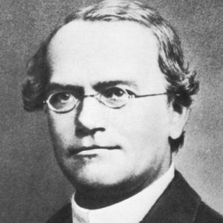
WALT know Gregor Mendel
http://www.biography.com/people/gregor-mendel-39282

Slide 15
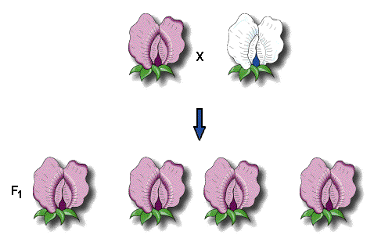
Mendel’s Experiment
P

Slide 16
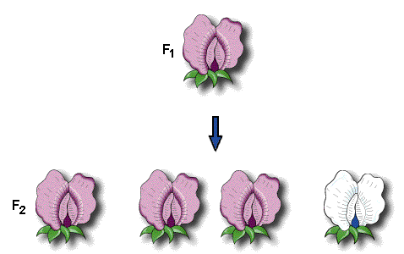

Slide 18
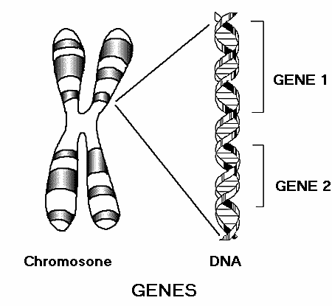
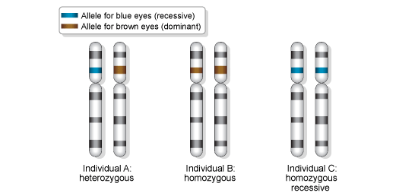
Source : www2.warwick.ac.uk
Source : bbc.co.uk
Gene is the basic functional unit of hereditary that codes for a certain protein,
for example, eye colour.
The Human Genome Project has estimated that humans
have between 20,000 and 25,000 genes.
Every person has two copies of the same gene from each parent.
Allele is one of a pair of the same gene that appears at a specific location on a specific
chromosome and control the same characteristics.

Slide 19
Allele

Slide 20
Source : bbc.com.uk
Alleles can be dominant or recessive. This is indicated by capital letter or small letter.
For example : BB, Bb or bb. You always use the letter of the dominant trait.

Slide 21
He was the Father of Modern Genetics!!!
Experiment
Watch Youtube
https://www.youtube.com/watch?v=cWt1RFnWNzk
https://www.youtube.com/watch?v=Mehz7tCxjSE
Task : Worksheet
https://www.youtube.com/watch?v=NWqgZUnJdAY

Slide 22
Terminology
Trait - any characteristic that can be passed from parent to offspring.
Heredity - passing of traits from parent to offspring.
Genetics - study of heredity
(Merkmal, Vererbung, Genetik)

Slide 23
WALT know Mendel‘s Laws of Inheritance
1. Law of Dominance – one dominant allele masks the
effect of the recessive allele.
A dominant allele produces the same phenotype
in heterozygotes and homozygotes.
(pheno=physical characteristics)
(geno=genetic information showing alleles)
2. Law of Segregation
Separation of a parent allele and the chance of getting
this gene is ½.
It is a random chance like flipping a coin.
3. Law of Independent Assortment
Genes for different traits segregate independently during
gamete formtaion.
For example, gene for pea colour separate independently
to gene for pea texture.
Results in variation among offsprings.
Does not affect each other for eg. Hitch hiker thumb and
attached earlobe.

Slide 24
Videos
Watch
https://www.youtube.com/watch?v=Mehz7tCxjSE
https://www.youtube.com/watch?v=GTiOETaZg4w
https://www.youtube.com/watch?v=NWqgZUnJdAY

Slide 25
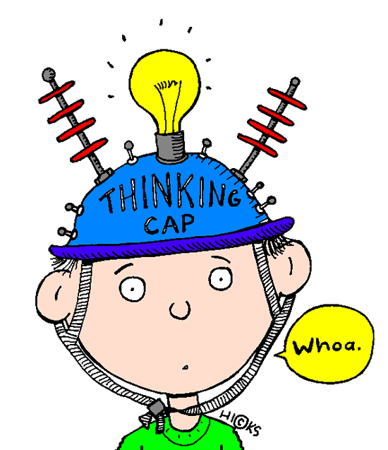
Genetics Quiz
A coin is flipped four times and comes up head each time.
What is the probability that the next flip will come up with a head?
2. Classify the following as heterrozygous or homozygous.
RR, Rr, yy, YYRr
3. Round (R) is dominant to wrinkled (r). Yellow (Y) is dominant to green (y).
What is the phenotype of the following?
Yy, Rr, yy, RrYy
4. What is the probability of Rr x Rr producing wrinkled seeds? Use a Punnett Square.
5. What is the probability of Yy X yy producing green seeds? Use a Punnett Square.
6. What is probability of RrYy X RRYy would produce RrYy? Use a Punnett Square.

Slide 26
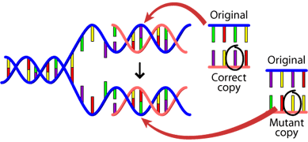
WALT know what mutation is
Knowledge harvest – What do you know about mutation?
What does the word mean to you?
Watch https://www.youtube.com/watch?v=VJycRYBNtwY
https://www.youtube.com/watch?v=8s4he3wLgkM

Slide 27
Two types :
Hereditary mutations
Acquired mutations
Mutation refers to a permanent change in the
DNA of an organism.
It can affect a single base pair or a whole
section of a DNA.
There are many ways in which this change can happen.

Slide 28
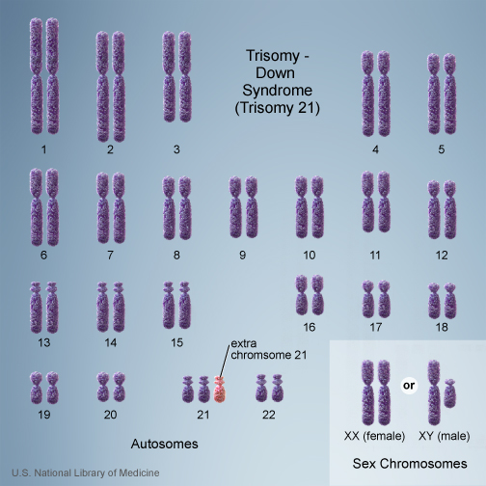
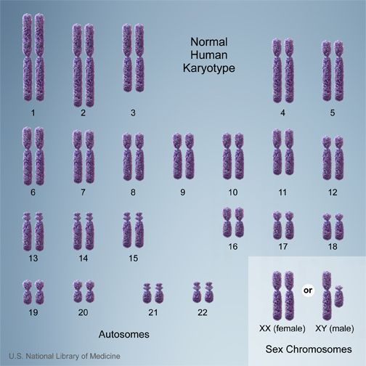
Are all mutations bad???
Down Syndrome
Normal

Slide 29
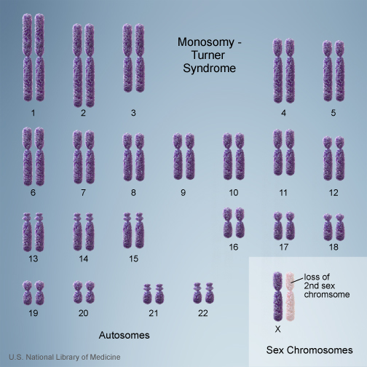
Turner Syndrome is a condition
caused by monosomy (loss of one
chromosome).
Do you know of other
conditions?

Slide 30
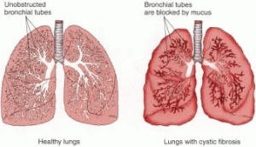
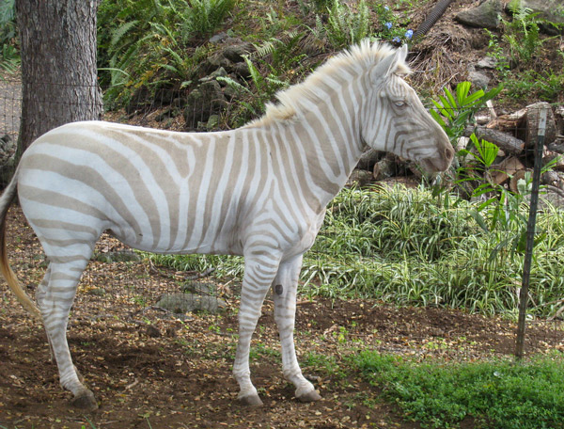
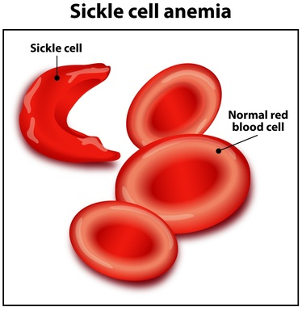
- Albinism
- Cystic fibrosis (Mukoviszidose)
- Sickle cell anemia

Slide 31
https://www.youtube.com/watch?v=4p1ZihXb29U
https://www.youtube.com/watch?v=kCSjfxm1jgY

