Slide 1
Electronegativity
WALT:
Define what makes a molecule polar or non polar
Describe a molecules shape
Explain what effect dipoles have on a molecules shape.

Slide 2
https://www.youtube.com/watch?v=72CQe-_PJU4
Whoops………spot the mistakes!

Slide 3
Cheat sheet.
Polar molecules must contain polar bonds due to a difference in electronegativity between the bonded atoms. A polar molecule with two or more polar bonds must have a geometry which is asymmetric in at least one direction, so that the bond dipoles do not cancel each other.
While the molecules can be described as "polar covalent", "nonpolar covalent", or "ionic", this is often a relative term, with one molecule simply being more polar or more nonpolar than another. However, the following properties are typical of such molecules.
A molecule is composed of one or more chemical bonds between molecular orbitals of different atoms. A molecule may be polar either as a result of polar bonds due to differences in electronegativity as described above, or as a result of an asymmetric arrangement of nonpolar covalent bonds and non-bonding pairs of electrons known as a full molecular orbital.
Polar molecules[edit]
The water molecule is made up of oxygen and hydrogen, with respective electronegativities of 3.44 and 2.20. The dipoles from each of the two bonds (red arrows) add together to make the overall molecule polar.
A polar molecule has a net dipole as a result of the opposing charges (i.e. having partial positive and partial negative charges) from polar bonds arranged asymmetrically. Water (H2O) is an example of a polar molecule since it has a slight positive charge on one side and a slight negative charge on the other. The dipoles do not cancel out resulting in a net dipole. Due to the polar nature of the water molecule itself, polar molecules are generally able to dissolve in water. Other examples include sugars (like sucrose), which have many polar oxygen–hydrogen (−OH) groups and are overall highly polar.
If the bond dipole moments of the molecule do not cancel, the molecule is polar. For example, the water molecule (H2O) contains two polar O−H bonds in a bent (nonlinear) geometry. The bond dipole moments do not cancel, so that the molecule forms a molecular dipole with its negative pole at the oxygen and its positive pole midway between the two hydrogen atoms. In the figure each bond joins the central O atom with a negative charge (red) to an H atom with a positive charge (blue).
The hydrogen fluoride, HF, molecule is polar by virtue of polar covalent bonds – in the covalent bond electrons are displaced toward the more electronegative fluorine atom. Ammonia, NH3, molecule the three N−H bonds have only a slight polarity (toward the more electronegative nitrogen atom). The molecule has two lone electrons in an orbital, that points towards the fourth apex of the approximate tetrahedron, (VSEPR). This orbital is not participating in covalent bonding; it is electron-rich, which results in a powerful dipole across the whole ammonia molecule.
Resonance Lewis structures of the ozone molecule
In ozone (O3) molecules, the two O−O bonds are nonpolar (there is no electronegativity difference between atoms of the same element). However, the distribution of other electrons is uneven – since the central atom has to share electrons with two other atoms, but each of the outer atoms has to share electrons with only one other atom, the central atom is more deprived of electrons than the others (the central atom has a formal charge of +1, while the outer atoms each have a formal charge of −​1⁄2). Since the molecule has a bent geometry, the result is a dipole across the whole ozone molecule.
When comparing a polar and nonpolar molecule with similar molar masses, the polar molecule in general has a higher boiling point, because the dipole–dipole interaction between polar molecules results in stronger intermolecular attractions. One common form of polar interaction is the hydrogen bond, which is also known as the H-bond. For example, water forms H-bonds and has a molar mass M = 18 and a boiling point of +100 °C, compared to nonpolar methane with M = 16 and a boiling point of –161 °C.
Nonpolar molecules[edit]
A molecule may be nonpolar either when there is an equal sharing of electrons between the two atoms of a diatomic molecule or because of the symmetrical arrangement of polar bonds in a more complex molecule.
Not every molecule with polar bonds is a polar molecule. Carbon dioxide (CO2) has two polar C=O bonds, but the geometry of CO2 is linear so that the two bond dipole moments cancel and there is no net molecular dipole moment; the molecule is nonpolar.

Slide 5
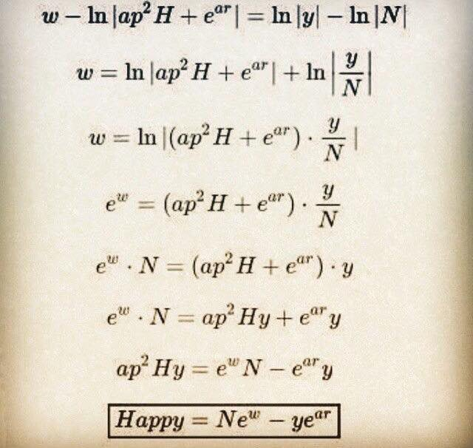
PHET simulations.
Choose your level and complete the sheet using the PHET simulation.

