Slide 1
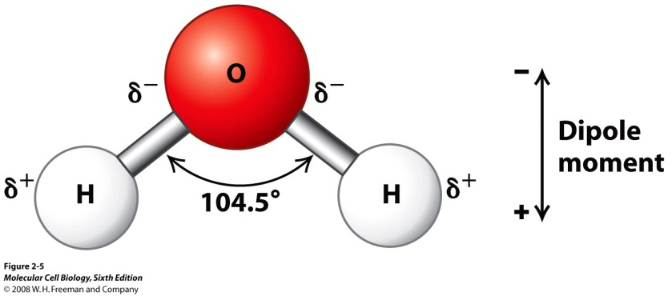
Intermolecular forces

Slide 2
Objectives
Name the 2 intermolecular forces
Describe the 2 intermolecular forces

Slide 3
For water
Is water a polar molecule?
Why?
What effect will this have on water molecules?

Slide 4
The boiling point of water
Look at the data on boiling points in the table. What would you expect the boiling point of water to be?
Why does this not match real life?
Compound | Boiling point /°C | Period
TeH₂ | 5 | 5
SeH₂ | -40 | 4
H₂S | -60 | 3
H₂O | ? | 2

Slide 5
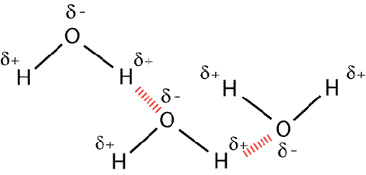
The boiling point of water
If water was to follow the pattern of other group 6 compounds, its boiling point should be around -80°C
It is much higher because the δ- of one molecule attracts the δ+ part of another molecule (hydrogen bonding)
This means it needs extra heat energy to break the bonds between molecules
Compound | Boiling point /°C | Period
TeH₂ | 5 | 5
SeH₂ | -40 | 4
H₂S | -60 | 3
H₂O | ? | 2

Slide 6
Hydrogen bonding
This is a special type of dipole attraction between the hydrogen of a polar molecule and the unbonded electron pair of an electronegative atom (F, O or N)
This means the bonding between water molecules is hydrogen bonding
Hydrogen bonds are around half the strength of covalent bonds

Slide 7
Hydrogen bonding or not?
HCl
HF
NH₃
CH3CHOH
CH₄

Slide 8
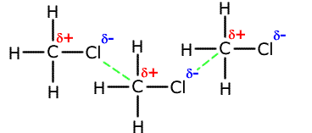
Van der Waal’s forces
These are weaker forces between molecules due to dipole attraction (and others)
Eg between chloromethane molecules

Slide 9
Questions
What type of bonding happens between molecules of
Water (H₂O)
Carbon dioxide (CO₂)
Ammonia (NH₃)
Methane (CH₄)

Slide 10
Objectives
Name the 2 intermolecular forces
Describe the 2 intermolecular forces

