Slide 1
What information can the modern periodic table show?

Slide 2
The wonders of the Periodic Table

Slide 3
Name the block
Name the group
Name the block
Name the group

Slide 4
Colour code your periodic table.
Using colouring pencils, colour the different groups to show that those elements have similar properties
Add text to your PT to explain the properties.

Slide 6
Metal conducts electricity, solids can be ductile, malleable
Metals tend to have high boiling& melting points
Non-metals generally are insulators, can be brittle solids
Non-metals top right
Groups 5,6,& 7 can gain electrons to form negative ions
Metal elements left right
Group 1, 2 & 3 tend to lose electrons to form positive ions

Slide 7
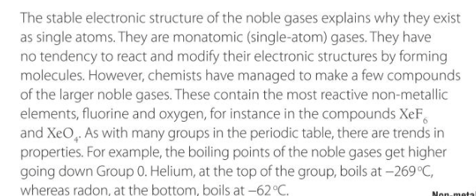
Group 0= noble gases.
They have 8 electrons in the outermost shell→ making the atoms very stable
Monoatomic
Very unreactive
Modify their electronic structures by forming molecules

Slide 8
Check point 1
Hint: Check the outermost shell!

Slide 9
Check your answers

Slide 10
Check point 2

Slide 11
Check your answers

Slide 12
Summary What the periodic table shows us…

Slide 13
Fact

Slide 14
What the periodic table shows us…

Slide 15
Fact

Slide 16
What the periodic table shows us…

Slide 17
Complete the sheet

Slide 19
Practise further
Everyone
Extension

