Slide 1
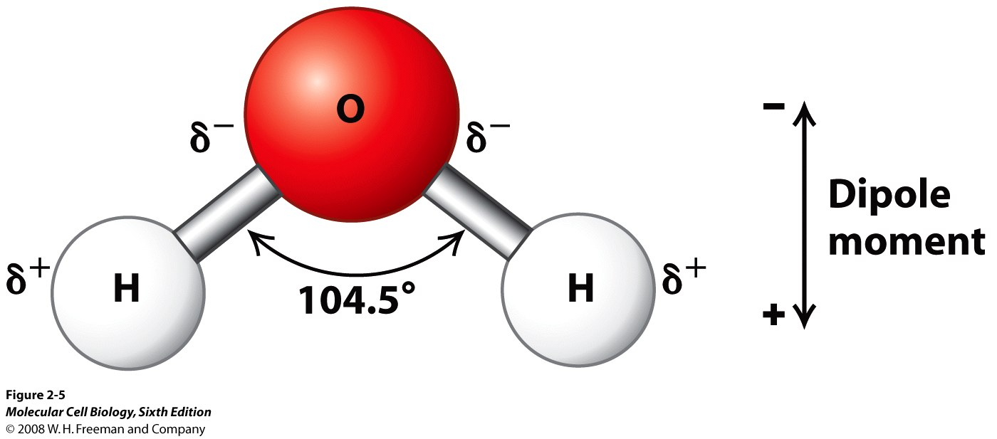
Electronegativity and molecule shapes WALT:
State the definition of electronegativity
Describe what is meant by polar and non polar bonds.
Explain how the shape of a molecule is affected by electron pairs and polarity

Slide 2
https://www.youtube.com/watch?v=ojgrvPnbPj4 Whooops! Spot the mistakes.
Wot is electronegativity?
What ist he most electronegative element?
Discribe the polar bond.
Discribe the non-polar bond.
Which is more electronegative, H or CL?
Which simbols show electronegativity?

Slide 3
Charges – back to basics
What charge do protons have?
What charge do electrons have?
What happens when 2 similar charges are near each other?
What happens when 2 opposite charges are near each other?

Slide 4
Covalent bonding – a reminder
What is the basis of covalent bonding?
What would happen if one of the atoms in a molecule attracted electrons more than other atoms?

Slide 5
Electronegativity (die Elektronegativität)
Definition: The tendency of an atom, or group of atoms, to attract electrons.
The electronegativity of an atom depends on
?
?

Slide 6
Electronegativity (die Elektronegativität)
Definition: The tendency of an atom, or group of atoms, to attract electrons.
The electronegativity of an atom depends on
The number of protons. More protons attract electrons more
The distance of the outer shell from the nucleus. The closer the electrons are to the nucleus, the more they are attracted

Slide 7
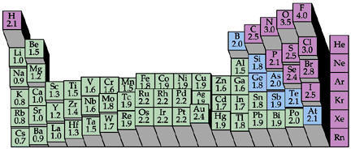
Measuring electronegativity
The Pauling scale is used (0 to 4)
Higher numbers mean more electronegativity
F = 4 (most electronegative)
C = 2.5
H = 2.1
O = 3.4

Slide 8
What does this mean for covalent compounds?

Slide 9
For covalent compounds
Covalent compounds share electrons
The more electronegative atom will pull shared electrons towards it, leaving part of the molecule negatively charged, and part of it positively charged
The molecule is then called polar

Slide 10
Eg. for water
Electronegativity of O is 3.5
Electronegativity of H is 2.1
This means the shared electrons are closer to the O atom
This means the O part of the molecule is more negatively charged, and the hydrogen parts are more positively charged

Slide 11
Task
Draw stick diagrams to show these molecules – include the charges
CO₂ (carbon dioxide)
CH₄ (methane)
CCl₄ (carbon tetrachloride)
HF (hydrogen fluoride)
H₂O

Slide 12
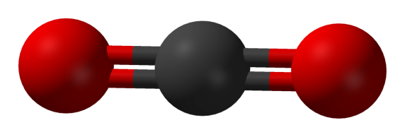
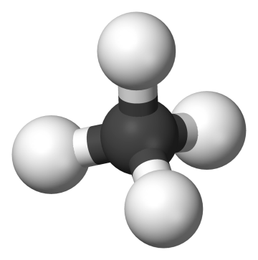
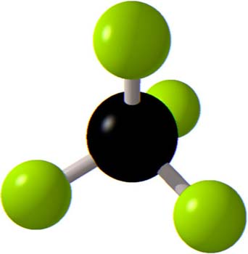
Why are they shaped like this?
CO₂
CH₄
Carbon tetrachloride

Slide 13
What about water?
Why is water shaped like this?
Are electrons found in pairs or on their own?
How does this affect where the electrons in the outer shell are found surrounding an atom?

Slide 14
Molecule shapes
When the atoms surrounding a central atom are the same, they spread as far as possible because their charges repel
As long as there are no unbonded electron pairs in the outer shell of the central atom
The electrons in the outer shell move in pairs
They move as far apart as possible from each other as –ve charges repel
In water, the oxygen has 2 unbonded pairs of electrons in the outer shell
These and the pairs involved in bonding move as far apart as possible

Slide 15
Task
Draw diagrams to show the shape of the following molecules, including any unbonded electron pairs
H₂O
CO₂

Slide 16
Task
Draw diagrams to show the shape of the following molecules, including unbonded electron pairs
H₂O
CO₂

Slide 17
Objectives
Describe electronegativity
Explain how the shape of a molecule is affected by electronegativity and polarity

