Slide 1
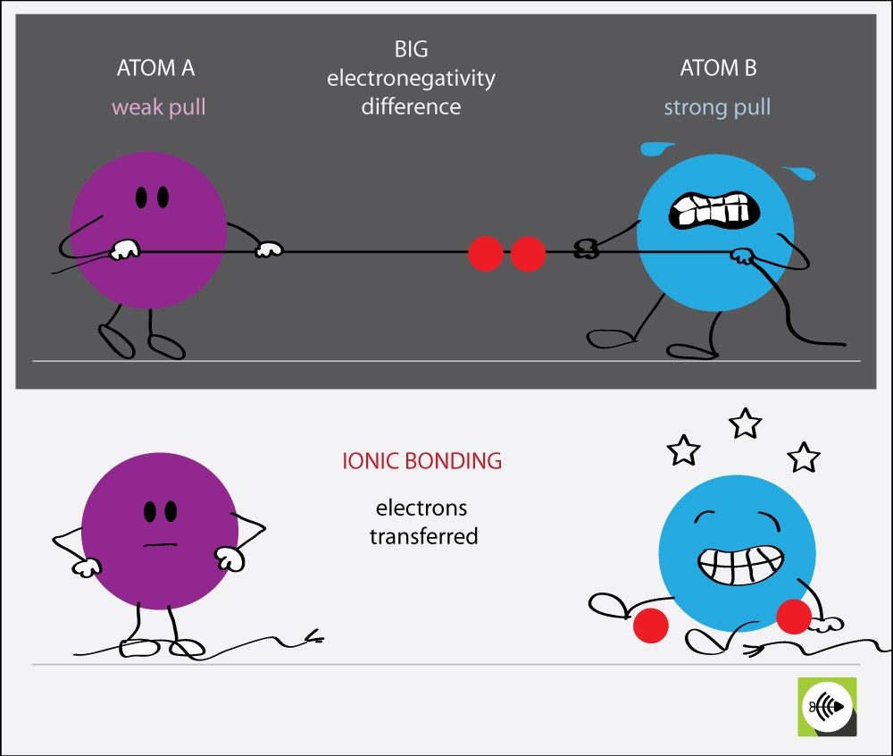
Electronegativity
Expert speaker Mr.Williamson is here to answer your questions on electronegativity. Yippee!
Using your knowledge, explain using examples and correct scientific terminology what is happening in the diagram opposite.
5 Minutes
Mr Williamson will correct our answers.

Slide 2
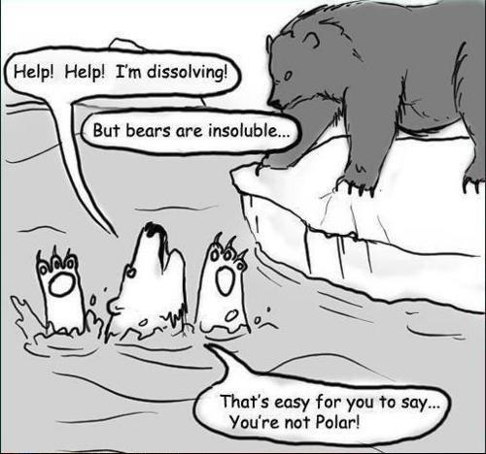
Intermolecular forces
WALT:
State two intermolecular forces.
Show the two intermolecular forces in displayed formula diagrams.
Describe the attraction in different sized molecules.
Explain why the boiling point of water is higher than expected.

Slide 3
https://www.youtube.com/watch?v=DECGNyC-x_s
Whoops……. correct the literacy errors!

Slide 4
For water
Is water a polar molecule?
Why?
What effect will this have on water molecules?

Slide 5
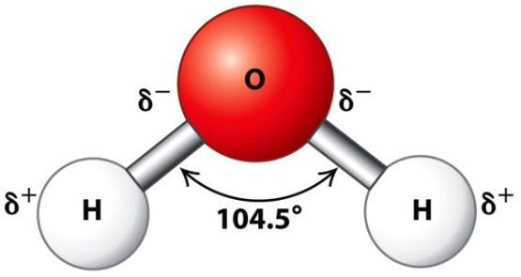
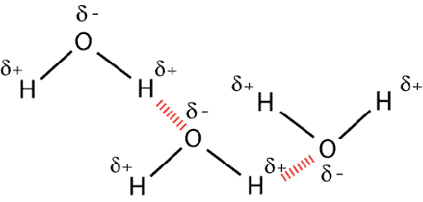
The boiling point of water
Task – practice drawing graphs
1. Draw a graph with period on the horizontal axis and boiling point on the verticle axis.
2. Estimate the boiling point of water
3. Describe why the boiling point of water is higher than we would expect it to be.
Compound | Boiling point /°C | Period
TeH₂ | 5 | 5
SeH₂ | -40 | 4
H₂S | -60 | 3
H₂O | ? | 2

Slide 6
Check your answers with a RED pen.
1
Boiling point of water…..about -80oC?
If water was to follow the pattern of other group 6 compounds, its boiling point should be around -80°C
It is much higher because the δ- of one molecule attracts the δ+ part of another molecule (hydrogen bonding)
This means it needs extra heat energy to break the bonds between molecules START HERE.
2
3

Slide 7
Hydrogen bonding
This is a special type of dipole attraction between the hydrogen of a polar molecule and the unbonded electron pair of an electronegative atom (F, O or N)
This means the bonding between water molecules is hydrogen bonding
Hydrogen bonds are around half the strength of covalent bonds

Slide 8
Look at the diagram below. What do you think is happeneing here?
Task
1. Draw the H2O molecules including the dipoles (δ- δ+)
2. Show where you think the weak hydrogen bonds would form.
3. Highlight the much stronger covalent bons between the atoms

Slide 10
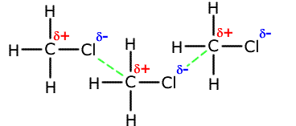
Van der Waal’s forces
These are weaker forces between molecules due to dipole attraction (and others)
Eg between chloromethane molecules

Slide 11
Questions
What type of bonding happens between molecules of
Water (H₂O)
Carbon dioxide (CO₂)
Ammonia (NH₃)
Extension – explain why the forces between H2O and CO2 are either the same or different.

Slide 12
Questions
What type of bonding happens between molecules of
Water (H₂O) Hydrogen bonding
Carbon dioxide (CO₂) Wan der Wahls forces
Ammonia (NH₃) Hydrogen bonding
Extension.
CO2 has no H atoms, so no hydrogen bonds. Non polar so there is no lone pair available on the electronegative atom.

Slide 13
3.6 Structure of simple molecules
Read the information on 3.6
Answer the questions at the bottom of the page.
Practise questions 3.6

Slide 14
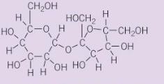
1. a. Describe what is meant by inter molecular forces. [1 mark]
Answer.
Intermolecular forces are defined as the set of attractive and repulsive forces that occur between the molecules as a result of the polarity of the molecules.
b. Look at the figure. What is the chemical formula of sucrose? [1 marks]
Answer.
C12H22O11.
2. a. Diamond has a very high melting point. Explain why. [2 marks]
Answer.
Diamond has a giant molecular structure. Each carbon atom is covalently bonded to four other carbon atoms. A lot of energy is needed to separate the atoms in diamond. This is because covalent bonds are strong, and diamond contains very many covalent bonds. This makes diamond’s melting point and boiling point very high.
b. Nitrogen gas has a very strong triple covalent bond holding the nitrogen atoms together in diatomic molecules. Explain why nitrogen has a boiling point of -196° [2 marks]
Answer.
Nitrogen molecules has weak inter molecular forces between them which can be easily broken down. As a result, it has a lower boiling point.
3. A compound called sulfur hexafluoride, SF₆, is used to stop sparks forming inside electrical switches designed to control large currents. State why the properties of this compound make it particularly useful in electrical switches. [2 marks]
Answer.
When electricity is used at high voltages, it can make very large sparks called arcs, that are similar to lightning. High-voltage equipment is usually sealed inside containers of sulfur hexafluoride gas at high pressure to stops arcs from happening.
The electric power industry has been using sulfur hexafluoride gas as a dielectric and insulating material for many years. Its popularity is mainly due to its insulating property which does not allow it to conduct heat and electricity.
4. Explain why the melting point of hydrogen chloride is -115°C, whereas sodium chloride’s melting point is 801°C [4 marks]
Answer.
hydrogen chloride is a simple molecular structure whereas sodium is a giant ionic structure. There is a strong electrostatic force of attraction between opposite charge ions in sodium chloride giving it a high melting point of 801.

Slide 15
