Slide 1
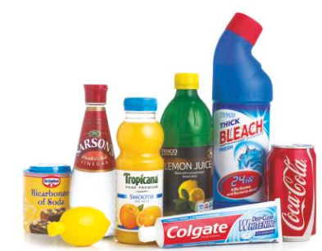
WALT:
Explain why solutions are acidic or alkali
Describe how to use UI
State how to use the pH scale to identify acidic or alkaline solutions
Investigate pH changes when a strong alkali neutralises a strong acid
Starter: name acids & alkalis found at home

Slide 2
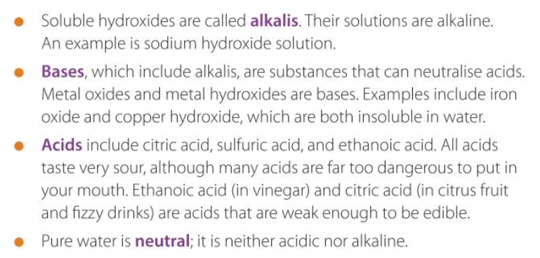
Task: Complete the gaps:
a
b
c
d
Word bank: neutral, alkalis, acids, bases

Slide 3
Check your answers

Slide 4
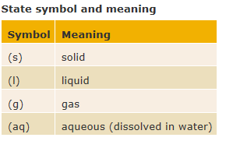
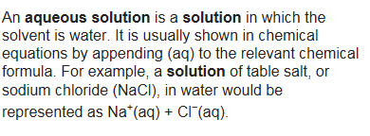
Theory: State symbols in chemical equations
Sometimes it is useful to know whether the reactants and products in a chemical reaction are solids, gases, liquids or dissolved in water. We can add state symbols to a symbol equation to show this.

Slide 5
Theory Acids and alkalis

Slide 6
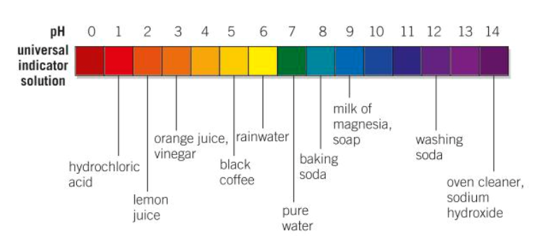
Starter: How can you tell how acidic or alkaline a substance is?

Slide 7
How is pH measured in this image?
Universal indicator
pH probe/sensor
Blue litmus paper

Slide 8
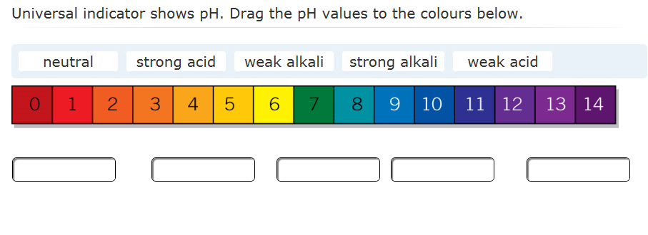
Test your knowledge
Self-assess: WWW/EBI

Slide 9
Test your knowledge
Self-assess: WWW/EBI

Slide 10
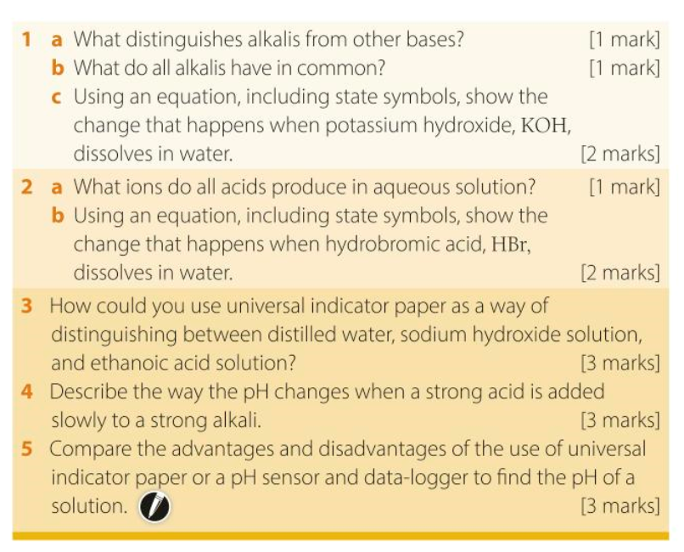
Reinforce your knowledge: Main
15 min

Slide 11
Check someone’s answers
www/EBI

Slide 12
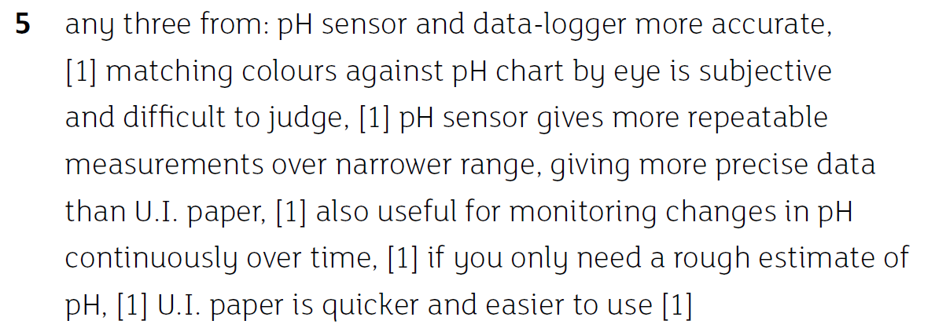
Check someone’s answers

Slide 13
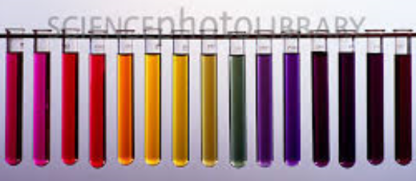
Extension Practical
Make a pH scale using an acid, an alkali & universal indicator
You’ll need 2 test tube racks and at least 10 (small) test tubes, pipettes

Slide 14
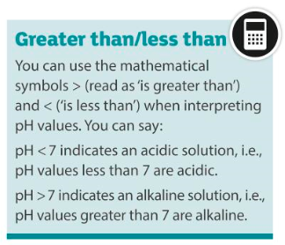
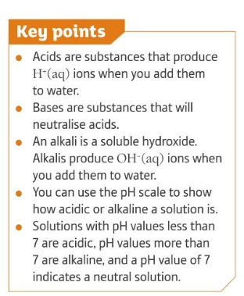
To summarise

