Slide 1
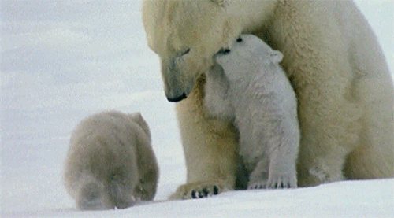
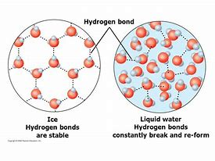
Salt content of water affects the floating of ice
Hypothesis

Slide 2
Hypothesis (already done)
Apparatus – what do we newed and HOW MANY/MUCH
Method – detail, always starts with 1)
Diagram – pencil and ruler
Results – in a results table
Conclusion – what happened and why
Evaluation – how could we improve next time
Ext: What consequence could this have on rising sea levels due to global warming?

Slide 3
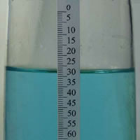
Figure 1: A freshwater ice cube floats in a beaker of concentrated saltwater. Note that the ice cube floats much higher in the saltwater than it would in a glass of freshwater because saltwater has a greater density.
Figure 2: When the freshwater ice melts, it raises the water level. Freshwater is not as dense as saltwater; so the floating ice cube displaced less volume than it contributed once it melted.

