Slide 1
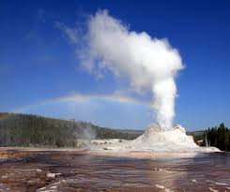
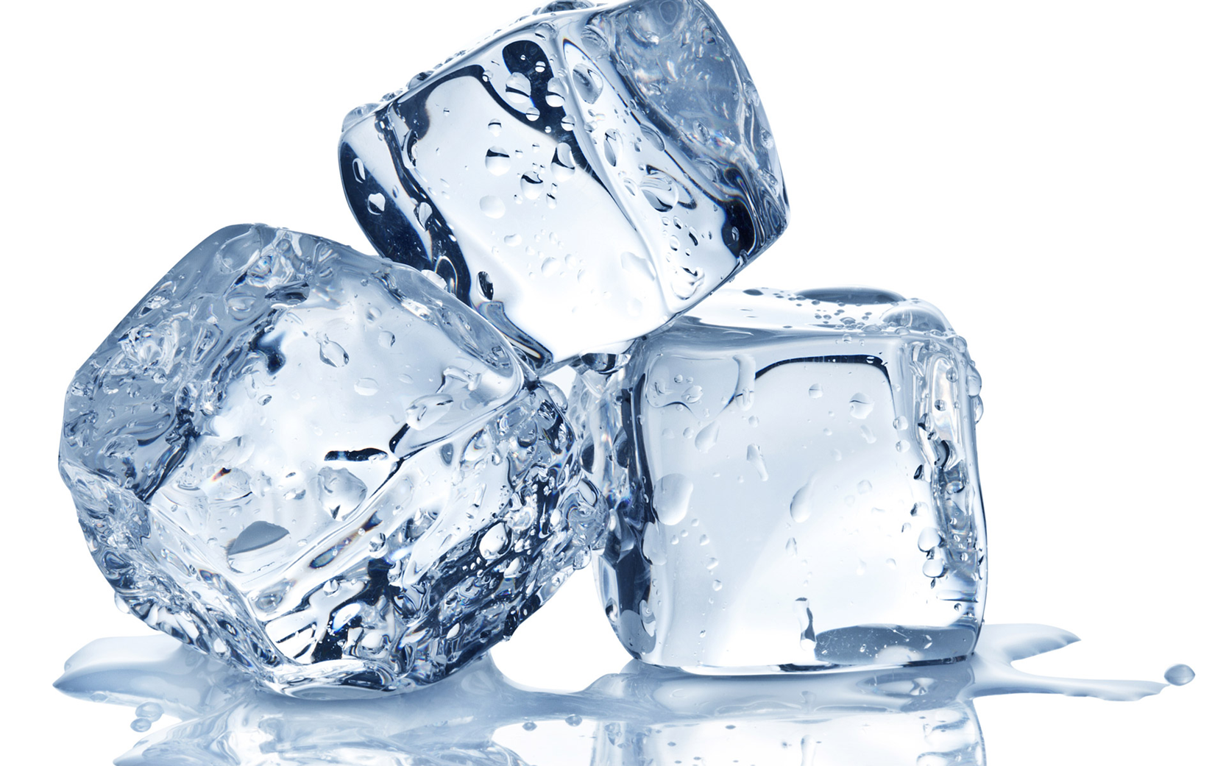
The states of matter
There are three states.
They are called solids, liquids and gas.
Most substances can exist in all three states but not at the same time.
Water can be solid: ice
liquid: water
or gas: steam
How does water change from one state to another?
You heat it or cool it.

Slide 2
The states of matter
There are three states.
They are called solids, liquids and gases.
Most substances can exist in all three states.
You can heat or cool them to make them change states.
Water can be solid (ice) and when you heat it, it becomes liquid (water). Heat it again and it becomes a gas (steam).

Slide 3
The properties of the states
Solids
Liquids
Gases
Keep the same shape
Keep the same volume
Keep the same volume
Take the same shape as their container
You can pour them
Doesn‘t keep the same volume
You can pour them

Slide 4
Write these words in the picture below: boil; condense; freeze, melt
_____
_____
_____
______

Slide 6
What have you learnt today?

