Slide 1
Atoms and electronic structure
WALT
Recap element names
Protons, neutrons, electrons
Electronic structures
Groups and periods
Ionisation energy

Slide 2
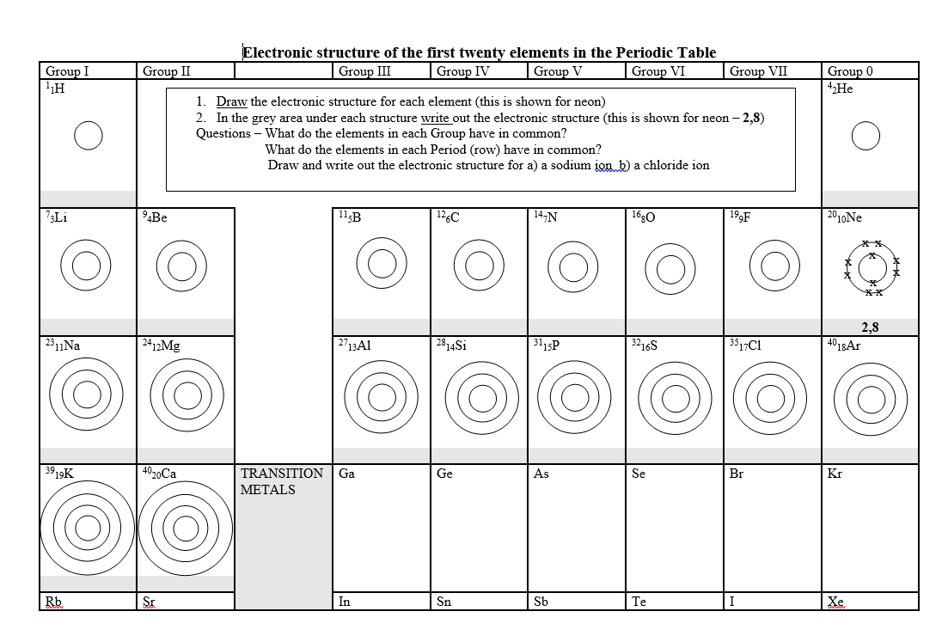
Draw the electronic structure of the elements in periodic table

Slide 3
History of the atom
WALT:
State that the model of the atom has changed over time.
Describe the experiments which have led to our current understanding of the model of the atom.
Explain ionisation energies using graphs and data.

Slide 4
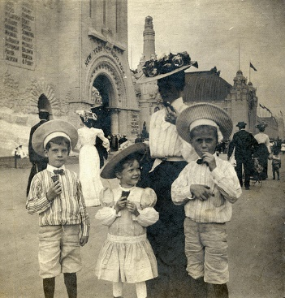
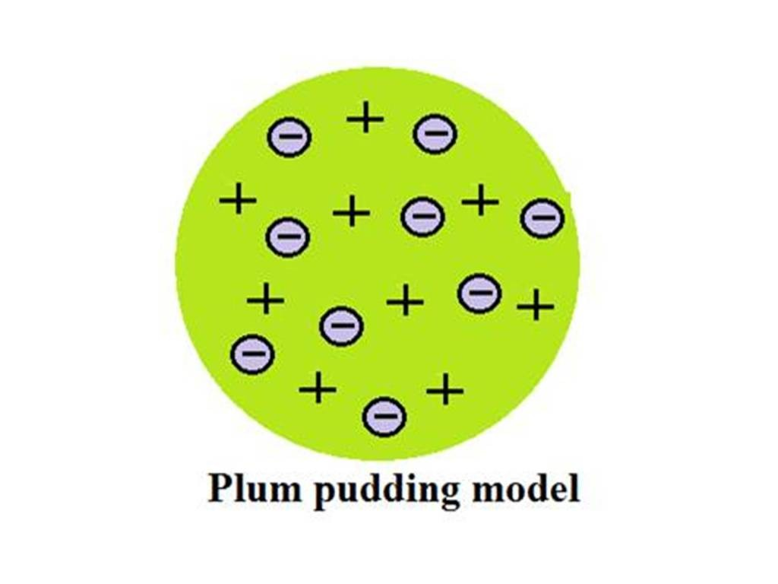
Plum pudding model – Thomson.

Slide 5
Rutherfords scattering experiment
https://www.bing.com/videos/search?q=Rutherford%27s+Gold+Foil+Experiment+Lab&&view=detail&mid=3B120FAD330C7FCAE2C83B120FAD330C7FCAE2C8&&FORM=VRDGAR
How did Rutherford show that the nucleus must contain the positive particles and that the negative particles were orbiting around the centre? START HERE.

Slide 6
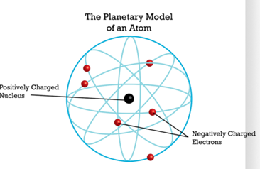
Ernest Rutherford – Planetary model

Slide 7
The positive alpha particles were scattered all around the detector. Some went straight through, some were deflected.

Slide 8
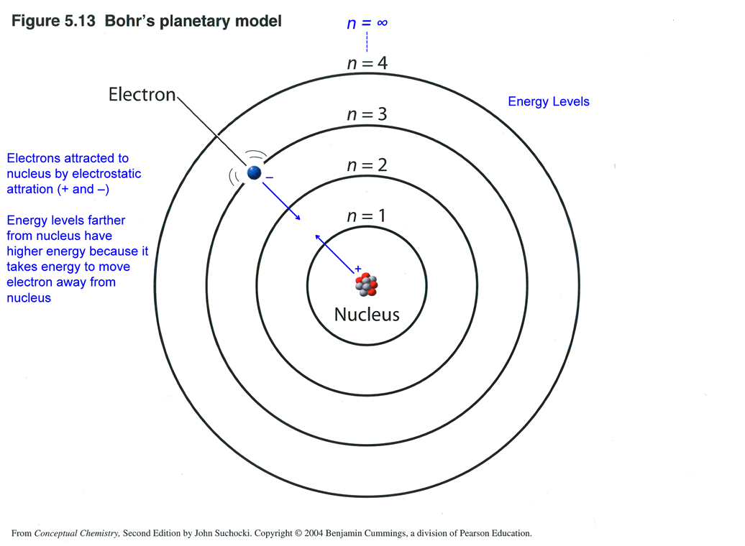
Bohr‘s Planetary model

Slide 9
Chadwick‘s Planetary model.

Slide 10
Ionisation energy
https://www.youtube.com/watch?v=hePb00CqvP0
Ionization energy is given a number of symbols including I, E, and I.E. Ionization energy is measured in kilojoules per mole (kJ mol-1) or electronvolts per atom (eV)*. (1 kJ/mol = 96.4869 x eV) Ionization energy, or ionisation energy, is the energy required to remove an electron from a gaseous atom or ion.

Slide 11
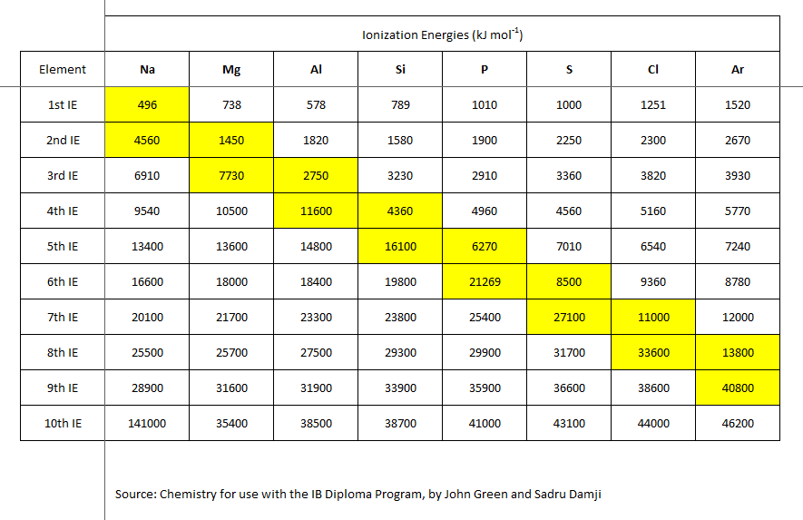
Ionisation energy table for the 2nd period of elements. „A period is just a term for a row, it has the same shell where the electrons go“ Task = Draw a graph with the ionisation energies for the different elements.

Slide 12
