Slide 1
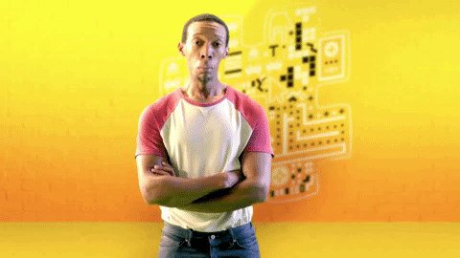
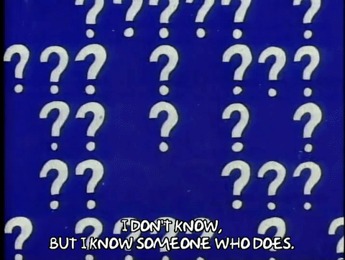
Put it together lesson.
Atoms, elements,energies and patterns.
Did you know………….The word atom means ‚uncuttable‘ in Greek.
Why would this now be an incorrect description of an atom?

Slide 2
Topic | Confidence (1-10 1 is best) | Done (tick) | Checked (tick) | Confidence (1-10 1 is best)
1.1 Metalic elements
1.2 Monotomic elements
1.3 Molecular elements
1.4 Covalent networks
1.5 Atomic sizes
1.6 Ionisation energies
1.7 Periodic patterns

Slide 3
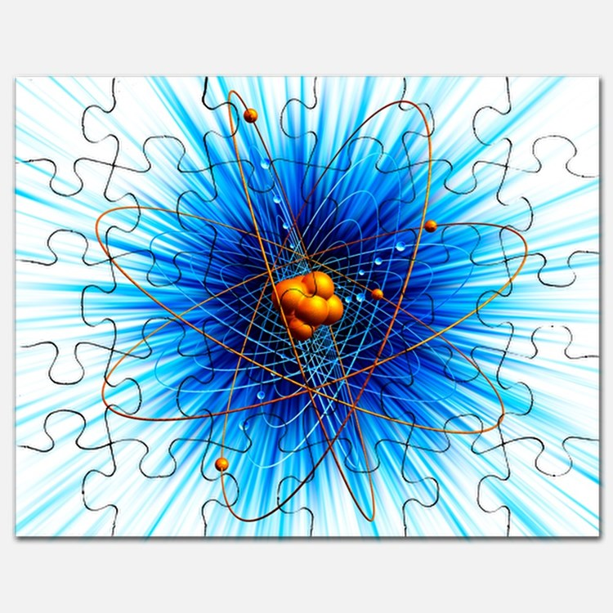
Elements and bonds.
WALT : State, describe and explain the formation of:
Metalic elements
Monotomic elements
Molecular elements
Covalent networks
Atomic sizes
Ionisation energies
Periodic patterns

Slide 4
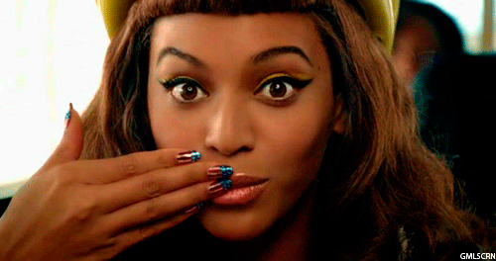
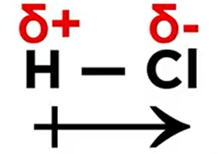
https://www.youtube.com/watch?v=PoQjsnQmxok Spot the mistakes!!!!
Wot is a molecule made up of?
What does an ion indicate Has happened to an element?
What do partikles of opposite charge have?
Why are ionic bonds stroong?
What happens when the the difference in electronegativity is less than about 1.7?
What bonds are formed between shared elektrons?
. Explain what these simbols mean.
What type of bonding happens if electronegativity betwen atoms is :
<0.5
0.5 – 1.7
>2.0

Slide 5
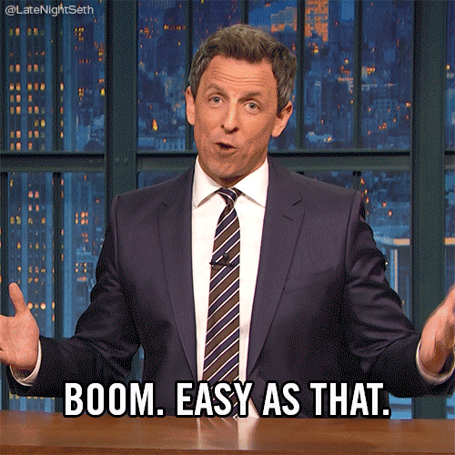

Slide 7
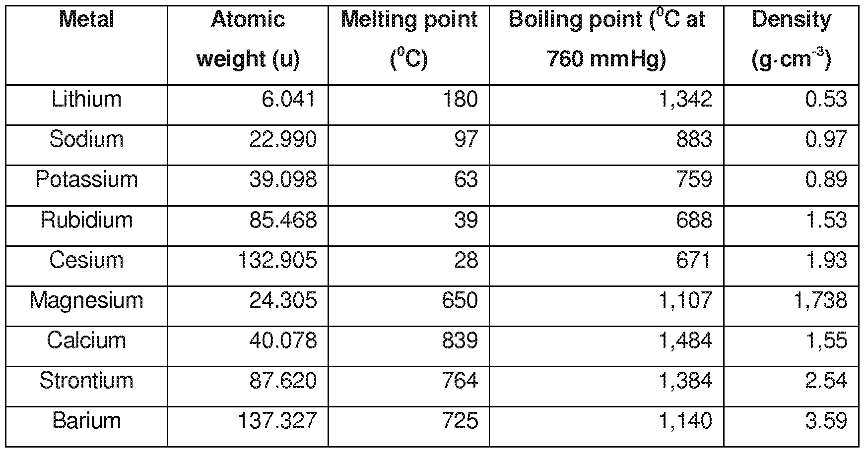
Complete the graph with the values from above.

Slide 8
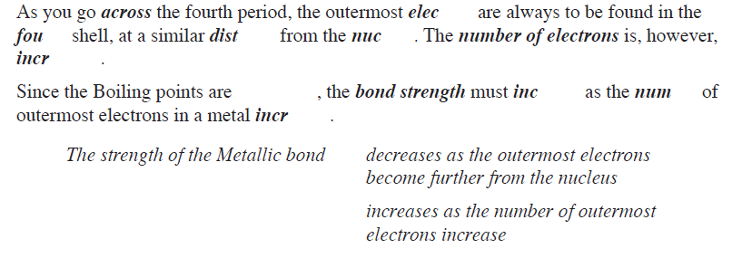
Metal | Boiling point (oC)
Pottasium | 759
Calcium | 1484
Galium | 2205

Slide 9
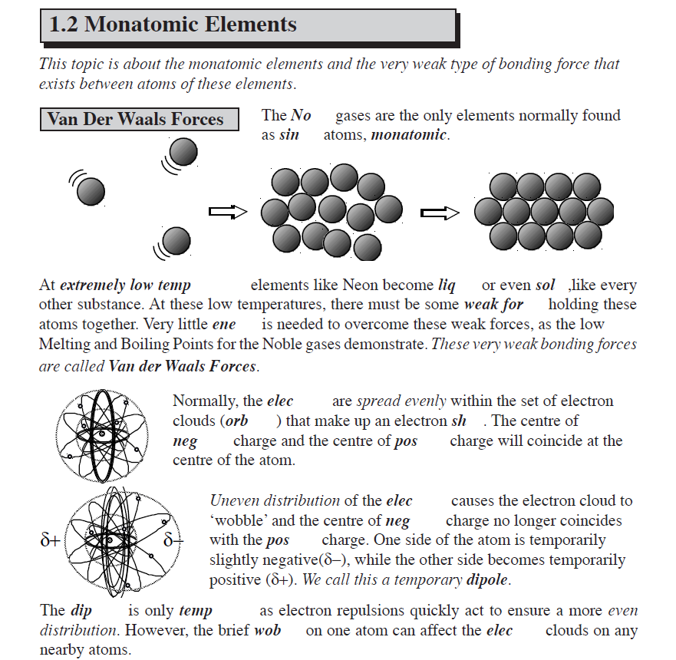

Slide 10
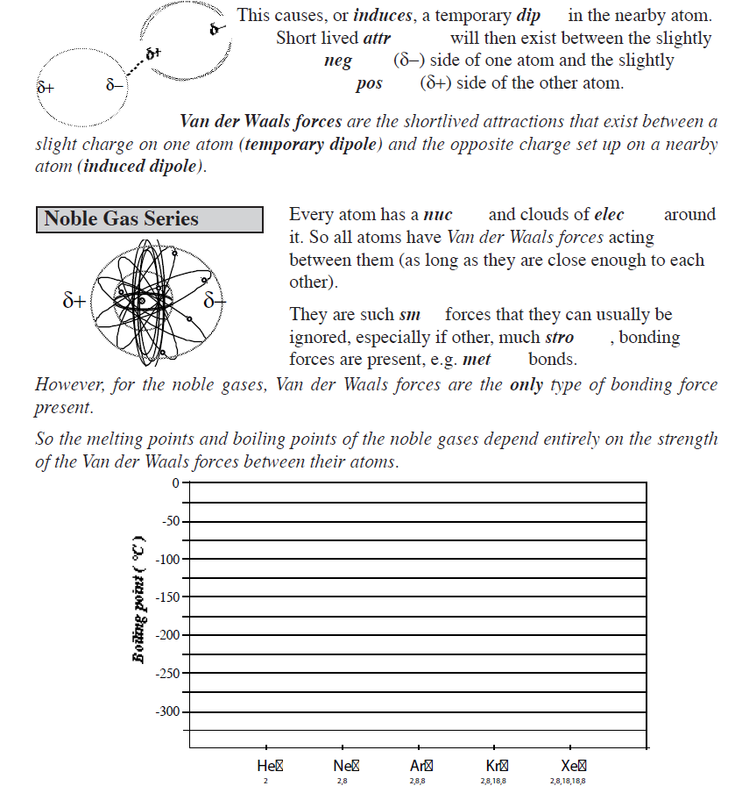

Slide 12
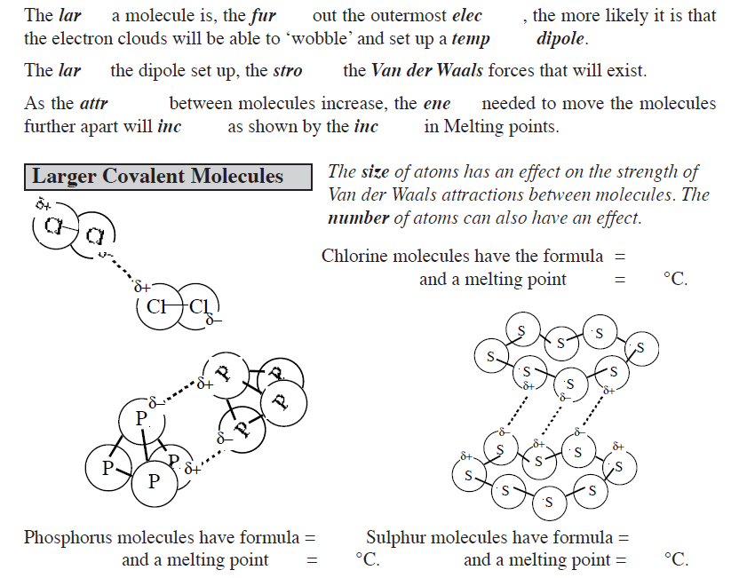
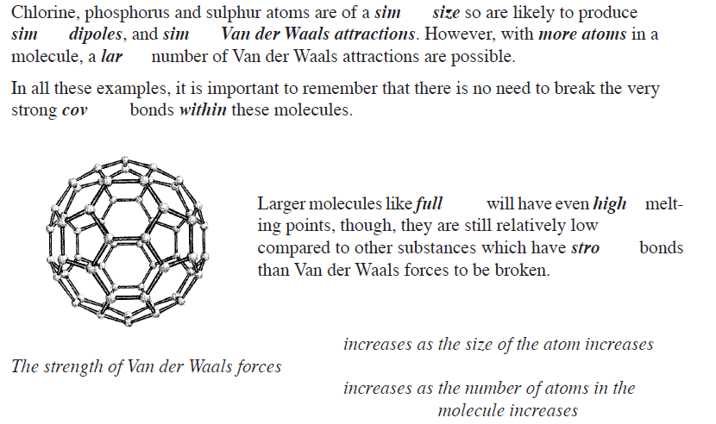

Slide 14
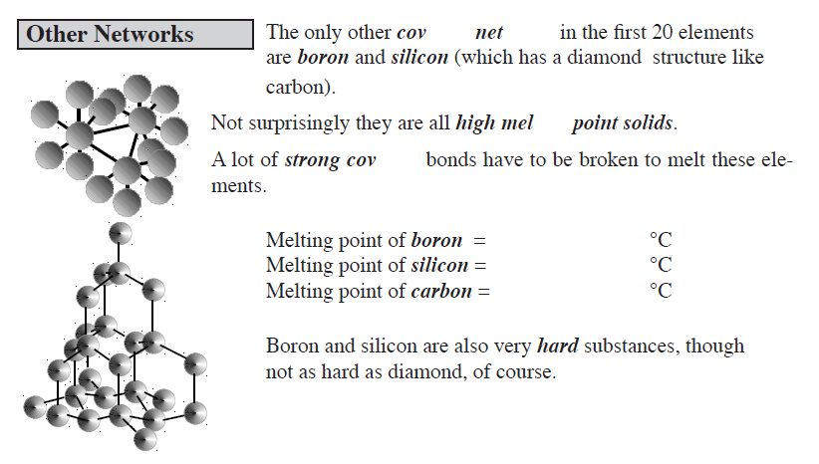

Slide 15
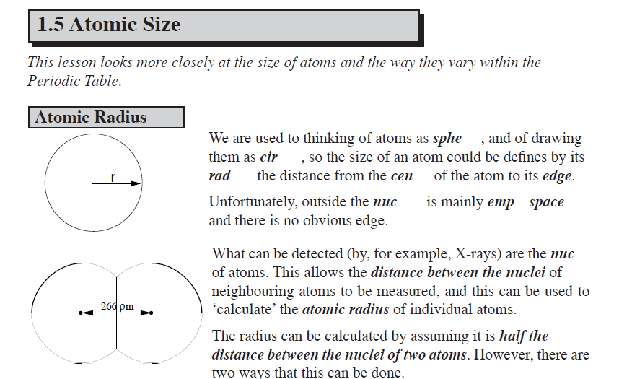

Slide 16
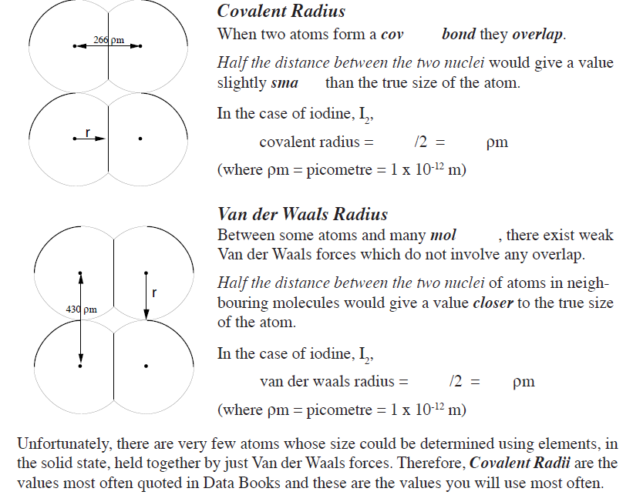
This is new, read carefully.

Slide 17
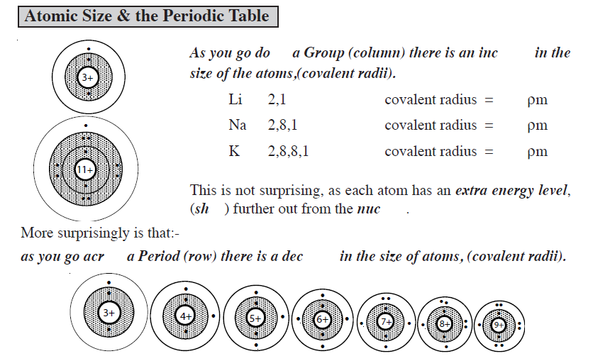

Slide 18
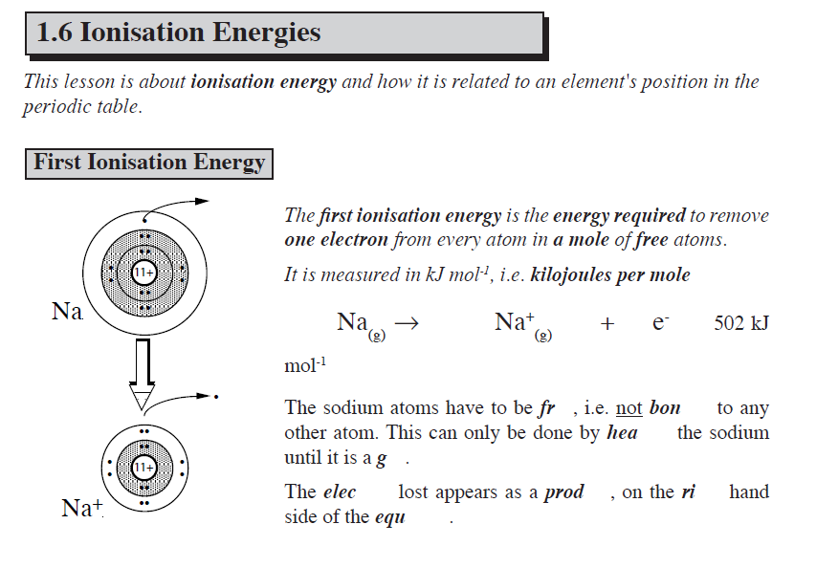

Slide 19
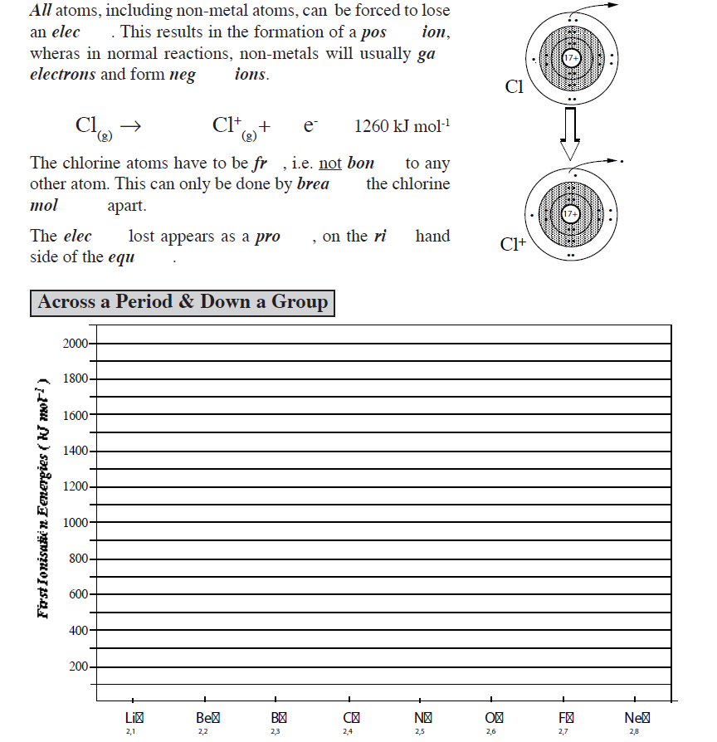
Use your ionisation periodic table to fill in this graph.

Slide 20
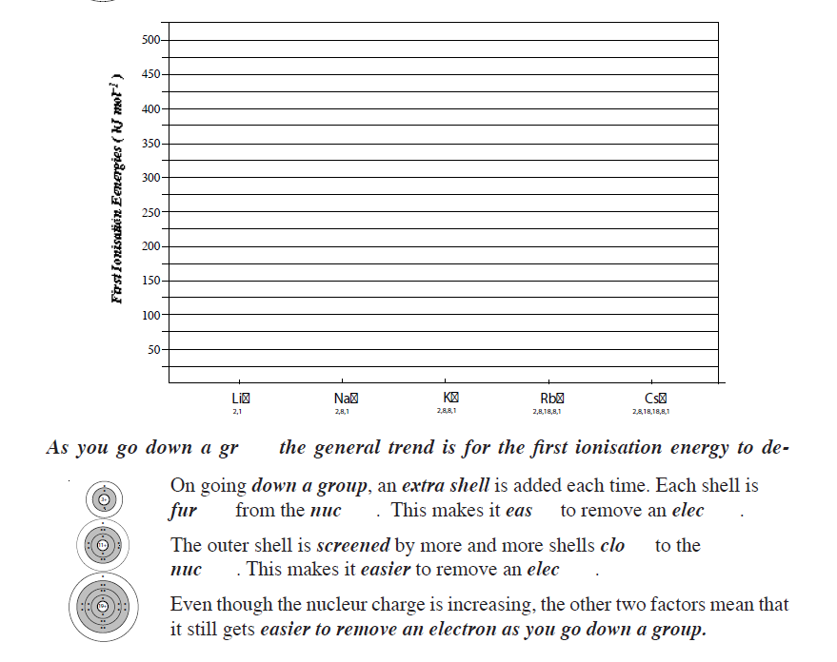

Slide 21
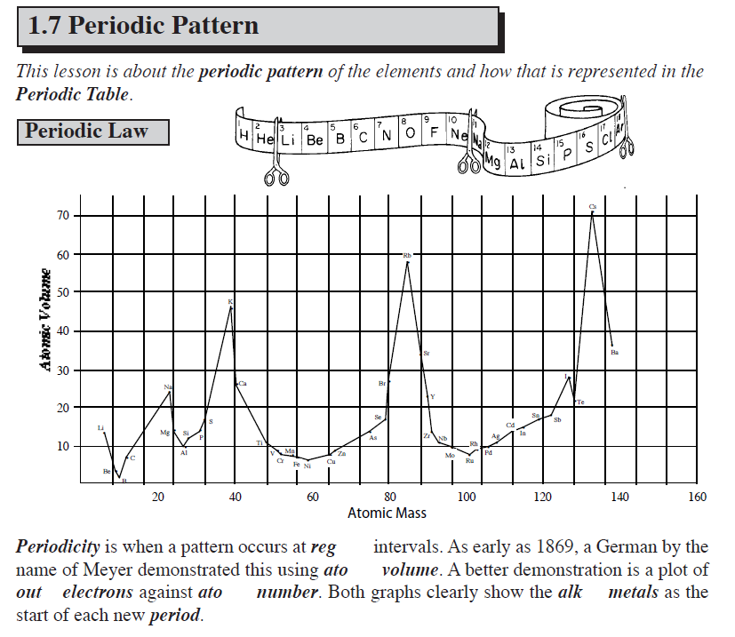

Slide 22
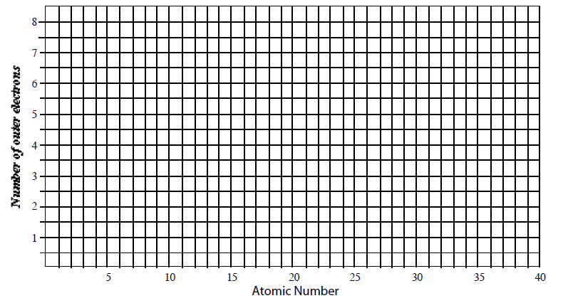
Use your periodic table to complete this graph for the first 40 elements
Did you know………Phosphorous is the Greek for ‚giver of light‘.It is also known as the planet venus or Morning Star. Why do you think it has connections to the word ‚light?‘

Slide 25
