Slide 1
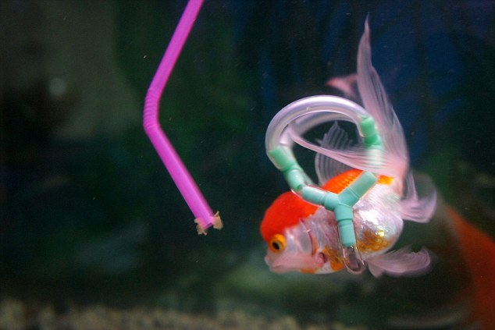
Floating and density
https://www.youtube.com/watch?v=6xamxeKSQUU

Slide 2
Density
Which are correct:
A very dense object :
is very heavy.
has a high mass
has closely packed particles. (that means the particles are very near together.)
is very big.
has a big volume.
will sink in water.

Slide 3
Density
Which are correct:
A very dense object :
is very heavy.
has a high mass
has closely packed particles. (that means the particles are very near together.) - true
is very big.
has a big volume.
will sink in water. - true

Slide 4
Finish the work sheets on density

Slide 5
Summary of density
Density tells you how tightly the particles of something are packed together.
You can calculate the density
$$Density=\frac{mass}{volume}$$
The units are grammes per centimetre cubed (g/cm³)
Each material has its own density.
E.g. the density of pure water is 1 g/cm³.
The density of iron is 7.8 g/cm³.
If the density of something is higher than the density of water, it will sink in water.
If you want to find what something is made of, you can calculate its density.

Slide 6
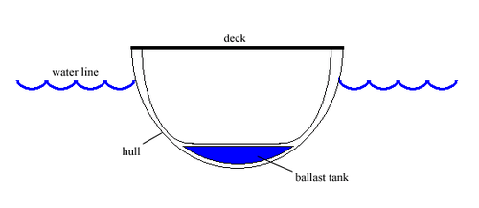
Ships, balls and fish
The density of an object is the mass of the object divided by the volume.
If an object is made of more than one material, you still measure the mass of the whole object and the volume of the whole object.
That is why steel ships float. Steel has a high density and will sink but ships are also full of air so the density of the whole ship is less than water and it floats.
Make notes and draw the picture.

Slide 7
And what about fish?
Fish (like people) are over two thirds water. Their density is similar to water. This means that they can float quite easily.
If they want to move up and down in the water, they can:
Use their fins and tail like sharks
Or use their swim bladder like a trout.
They put air into their swim bladder if they want to go up and take it out of they want to move down. When air goes into their swim bladder, the volume increases, but the mass doesn‘t change (much). This means the density of the fish goes down.
https://www.youtube.com/watch?v=0v86Yk14rf8

Slide 8
Find the answer.
Oak has a density of 0.85 g/cm³. Will it float or sink?
Ice floats on water. What does it tell you about its density?
Explain why steel ships don‘t sink.
Explain how a fish uses ist swim bladder. Talk about density.

Slide 9
What have you learnt today?
Next lesson you can bring something with you if you want to know what it is made of.
https://phet.colorado.edu/en/simulation/legacy/density

