Slide 1
Starter. What can we remember??!!

Slide 3
Go further.

Slide 4
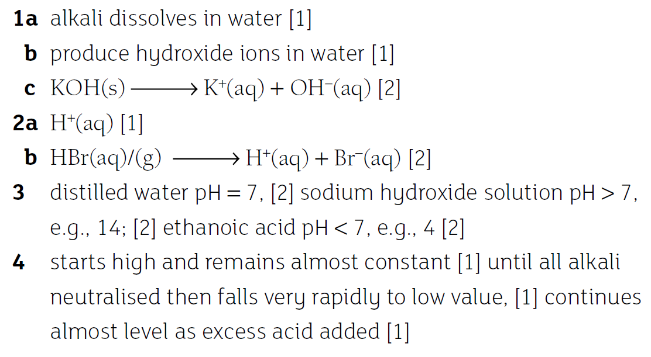
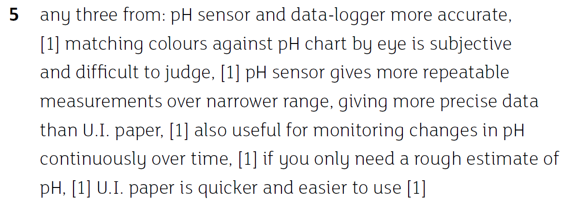

Slide 5
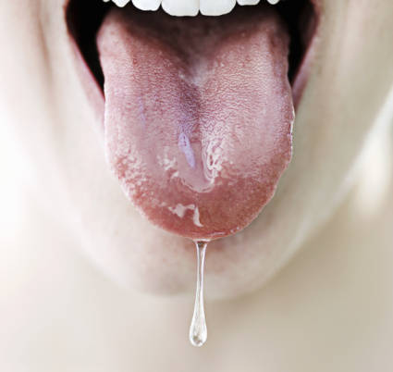
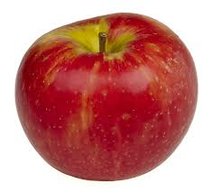
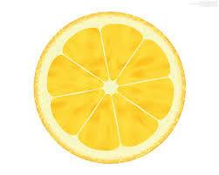

Slide 6
Acids and alkalis

Slide 7
Objectives
Describe acids and alkalis in terms of proton transfer

Slide 8
Acids and alkalis
What can you remember?
Lemons
Hydrochloric acid
Saliva pH 8
Sodium hydroxide ph 11

Slide 9
Terminology
The opposite of an acid is a base (Base)
Bases that dissolve are called alkalis (Alkalien)

Slide 10
Thinking time
What do all of these acids have in common?
HCl (hydrochloric acid)
H₂SO₄ (sulphuric acid)
HNO₃ (nitric acid)
CH₃CHOHCOOH (lactic acid)

Slide 11
Thinking time
What do all of these acids have in common?
HCl (hydrochloric acid)
H₂SO₄ (sulphuric acid)
HNO₃ (nitric acid)
CH₃CHOHCOOH (lactic acid)
They all have hydrogen in them

Slide 12
Thinking time - again
What is in a hydrogen ion?

Slide 13
Thinking time - again
What is in a hydrogen ion?
A normal hydrogen atom is a proton and an electron. So, a hydrogen ion (H⁺) is just a proton

Slide 14
Acids as proton donors
According to Brønsted
all acids are proton donors
All bases are proton acceptors
All reactions with acids or alkalis involve the transfer of a proton (H⁺ ion)

Slide 15
Acids and water
If we add HCl (hydrochloric acid) to water, what happens with the proton that HCl wants to donate?

Slide 16
Acids and water
If we add HCl (hydrochloric acid) to water, what happens with the proton that HCl wants to donate?
HCl + H₂O → Cl⁻ + H₃O⁺
HCl has donated a proton to the water molecule. We now have an oxonium ion (H₃O⁺) and a chloride ion (Cl⁻)

Slide 17
Alkalis and water
If we add NH₃ (ammonia) to water, what happens with the proton that NH₃ wants to accept?

Slide 18
Alkalis and water
If we add NH₃ (ammonia) to water, what happens with the proton that NH₃ wants to accept?
NH₃ + H₂O → NH₄⁺ + OH⁻
The ammonia has accepted a proton from water. We now have an ammonium ion (NH₄⁺) and a hydroxyl ion (OH⁻)

Slide 19
Water reacting with itself
Water will also react with itself, with one molecule donating a proton and another accepting it. What would the equation be?

Slide 20
Water reacting with itself
Water will also react with itself, with one molecule donating a proton and another accepting it.
H₂O + H₂O H₃O⁺ + OH⁻
The double arrow means that this reaction goes both ways at the same time

Slide 21
Strong and weak acids
Strong acids (Eg. HCl, H₂SO₄, HNO₃) are ones that completely split up into ions
Eg. HCl + H₂O → Cl⁻ + H₃O⁺
Weak acids are ones that only partially ionise

Slide 22
Objectives
Describe acids and alkalis in terms of proton transfer

