Slide 1
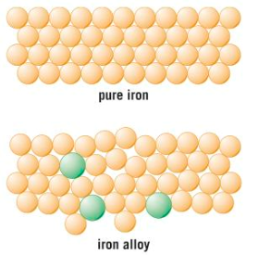
State similarities and differences between these 2 substances

Slide 2
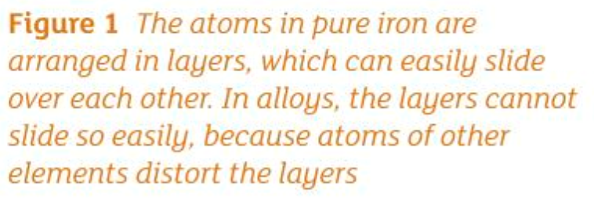

Slide 3
The fun man explaining metallic bonding. Enjoy!
https://www.youtube.com/watch?v=A-wTpLPICd0

Slide 4
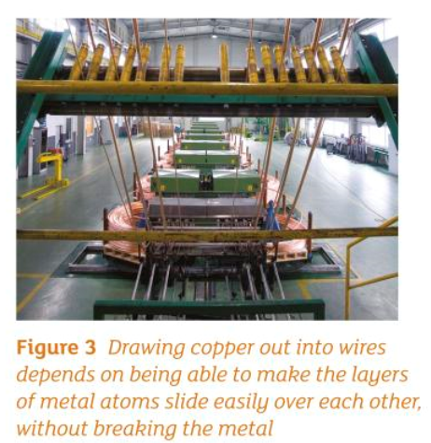
Ductile

Slide 5
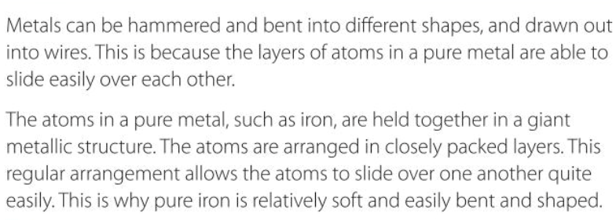
Metals and alloys
malleable

Slide 6
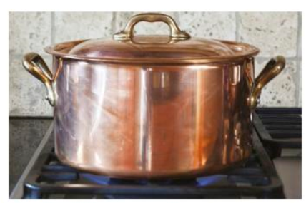
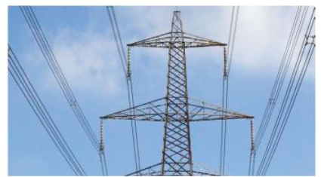
Most have high melting points
Good conductors of thermal heat
Good conductors of electricity

Slide 7
Explaining the properties of metals
Positive ions in a metal’s giant structure are bonded to each other by a sea of delocalised electrons
Their negative charge between the + ly charged ions holds the metal ions in position by electrostatic forces of attraction
Electrons are able to move throughout the whole giant lattice- this will enable the lattice to distort
Malleable and ductile (seen before)
High melting points
Good conductors of thermal energy and electricity

Slide 8
Check point 1

Slide 9
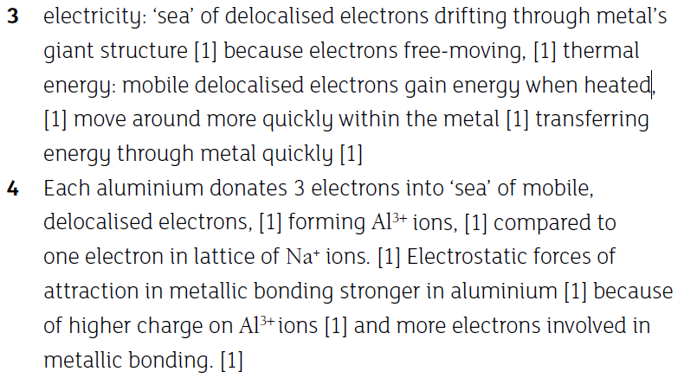
Check point 2

