Slide 1
Test: Cell Biology

Slide 2
Topics
Structure and function of animal and plant cells, similarities and differences
Diffusion/Osmosis
Plasmolysis/Deplasmolysis
Structure of the DNA (karyogram, structure of chromosomes, autosomes, sex chromosomes)
Cell cycle (Interphase, mitsois, cytokinesis, differences animal cell/plant cell→see copies p. 229-231)
Mitosis (function, phases)

Slide 3
Quiz

Slide 4
1
Function of the nucleus

Slide 5
2
What happens in interphase?

Slide 6
3
What is mitosis?

Slide 7
4
What is cytokinesis?

Slide 8
5
Why do molecules (e.g. of a perfume) spread out equally when sprayed into a room?

Slide 9
6
Plasmolysis – Deplasmolysis?

Slide 10
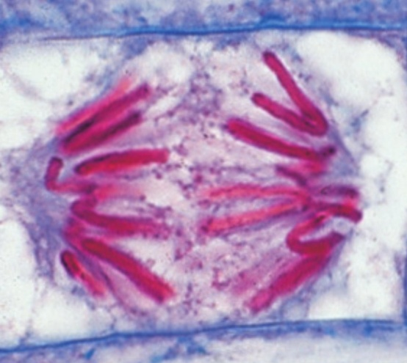
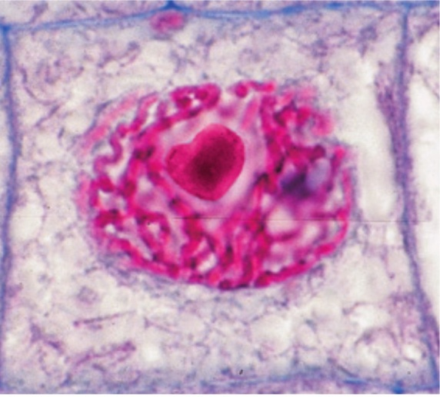
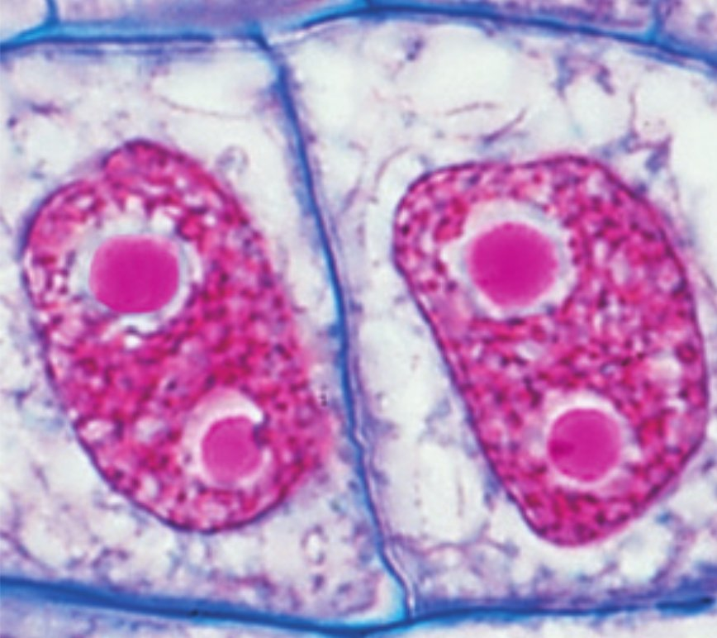
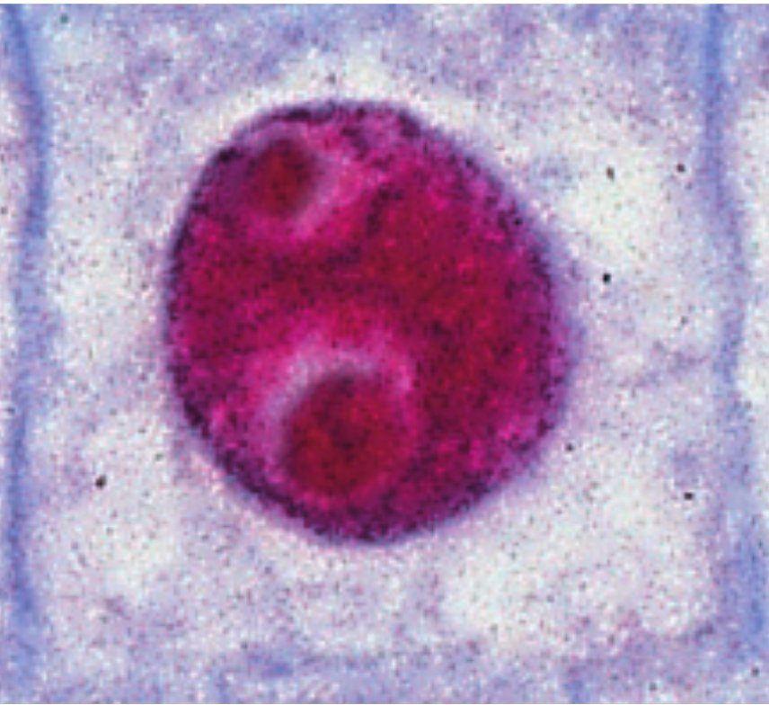
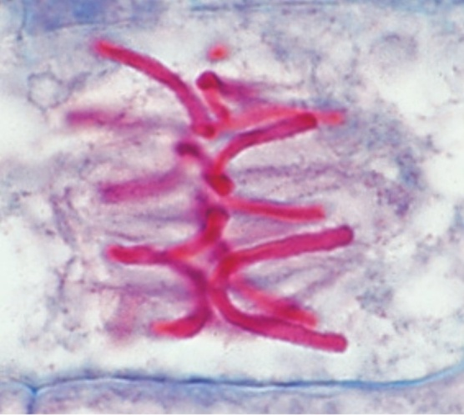
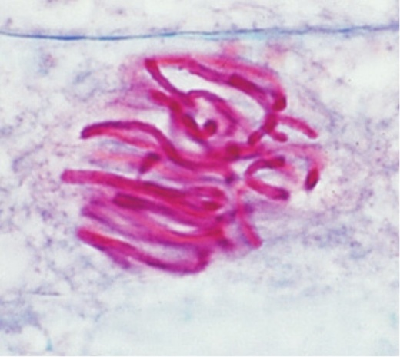
7
Put the pictures into the right order

Slide 11
8
 | vor Versuchsbeginn | in destilliertem Wasser | in 0,9%iger Kochsalzlösung | in 2%iger Kochsalzlösung
Länge der Kartoffelstücke | 8,7 cm | 9,2 cm | 8,7 cm | 8,2 cm
weitere Beobachtungen |  | knackig, bricht beim Biegeversuch | unverändert | weich, biegsam
Explain what happens with the pieces of potato in the different
solutions!

Slide 12
9
Why is it better to put the dressing on a salad right before you eat it instead of an hour beforehand?

Slide 13
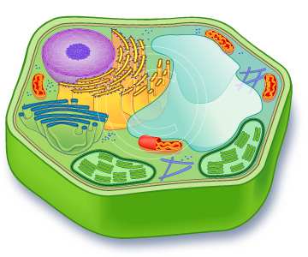
10
Label the cell structures and their functions.

Slide 14
END

